Slide 1
C++ Basics
Notes:
333
const

Slide 2
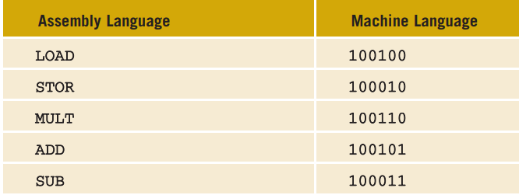
The Evolution of Programming Languages
Machine Language (0’s & 1’s – bits)
wages = rate * hours
Assembly language
Mnemonics
LOAD rate
MULT hours
STOR wages
Assembler

Slide 3
The Evolution of Programming Languages (cont’d.)
High-level languages
Basic, FORTRAN, COBOL, Pascal,
C, C++, C#, and Java
Compiler: translates a program written in a high-level language machine language

Slide 4
C++ Program Example
#include <iostream>
using namespace std;
int main()
{
cout << "My first C++ program." << endl;
return 0;
}
Sample Run (Output):
My first C++ program.

Slide 5
Execute C++ Program
To execute a C++ program:
Use an editor to create
a source program in C++
Preprocessor directives begin with # and are processed by a the preprocessor
Use the compiler to:
Check that the program obeys the rules
Translate into machine language (object program)
Linker:
Combines object program with other programs provided by the SDK to create executable code
Loader:
Loads executable program into main memory
The last step is to execute the program

Slide 6
Programming with the Problem Analysis–Coding–Execution Cycle
Programming is a process of problem solving
One problem-solving technique:
Analyze the problem
Outline the problem requirements
Design steps (algorithm) to solve the problem
Algorithm:
Step-by-step problem-solving process
Solution achieved in finite amount of time

Slide 7
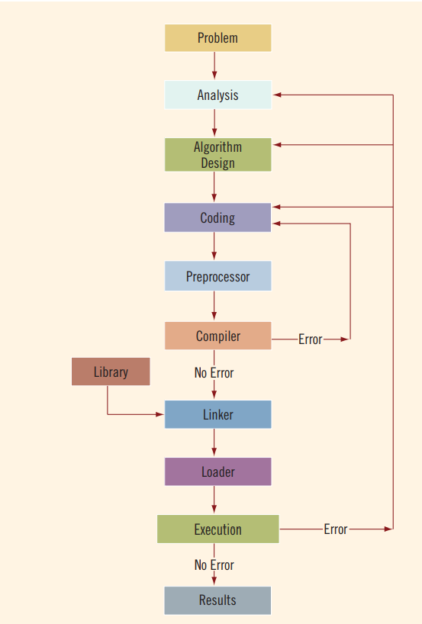

Slide 8
Detailed Steps
Run code through compiler
If compiler generates errors
Look at code and remove errors
Run code again through compiler
If there are no syntax errors
Compiler generates equivalent machine code
Linker links machine code with system resources
Once compiled and linked, loader can place program into main memory for execution
The final step is to execute the program
Compiler guarantees that the program follows the rules of the language
Does not guarantee that the program will run correctly

Slide 9
Example
Design an algorithm to find the perimeter and area of a rectangle
The perimeter and area of the rectangle are given by the following formulas:
perimeter = 2 * (length + width)
area = length * width

Slide 10
Basic Elements of C++

Slide 11
Objectives
In this chapter, you will:
Become familiar with the basic components of a C++ program, including functions, special symbols, and identifiers
Explore simple data types
Discover how to use arithmetic operators
Examine how a program evaluates arithmetic expressions

Slide 12
Objectives (continued)
Learn what an assignment statement is and what it does
Become familiar with the string data type
Discover how to input data into memory using input statements
Become familiar with the use of increment and decrement operators
Examine ways to output results using output statements

Slide 13
Objectives (continued)
Learn how to use preprocessor directives and why they are necessary
Explore how to properly structure a program, including using comments to document a program
Learn how to write a C++ program

Slide 14
The Basics of a C++ Program
Function: collection of statements; when executed, accomplishes something
May be predefined or standard
Syntax: rules that specify which statements (instructions) are legal
Programming language: a set of rules, symbols, and special words
Semantic rule: meaning of the instruction

Slide 15
Comments
Comments are for the reader, not the compiler
Two types:
Single line
// This is a C++ program. It prints the sentence:
// Welcome to C++ Programming.
Multiple line
/*
You can include comments that can
occupy several lines.
*/

Slide 16
Special Symbols
Special symbols
+
-
*
/
.
;
?
,
<=
!=
==
>=

Slide 17
Reserved Words (Keywords)
Reserved words, keywords, or word symbols
Include:
int
float
double
char
const
void
return

Slide 18
Identifiers
Consist of letters, digits, and the underscore character (_)
Must begin with a letter or underscore
C++ is case sensitive
NUMBER is not the same as number
Two predefined identifiers are cout and cin
Unlike reserved words, predefined identifiers may be redefined, but it is not a good idea

Slide 19
Identifiers (continued)
The following are legal identifiers in C++:
first
conversion
payRate

Slide 20
Whitespaces
Every C++ program contains whitespaces
Include blanks, tabs, and newline characters
Used to separate special symbols, reserved words, and identifiers
Proper utilization of whitespaces is important
Can be used to make the program readable

Slide 21
Data Types
Data type: set of values together with a set of operations
C++ data types fall into three categories:

Slide 22
Simple Data Types
Three categories of simple data
Integral: integers (numbers without a decimal)
Floating-point: decimal numbers
Enumeration type: user-defined data type

Slide 23
Simple Data Types (continued)
Integral data types are further classified into nine categories:

Slide 24
Simple Data Types (continued)
Different compilers may allow different ranges of values

Slide 25
int Data Type
Examples:
-6728
0
78
+763
Positive integers do not need a + sign
No commas are used within an integer
Commas are used for separating items in a list

Slide 26
bool Data Type
bool type
Two values: true and false
Manipulate logical (Boolean) expressions
true and false are called logical values
bool, true, and false are reserved words

Slide 27
char Data Type
The smallest integral data type
Used for characters: letters, digits, and special symbols
Each character is enclosed in single quotes
'A', 'a', '0', '*', '+', '$', '&'
A blank space is a character and is written ' ', with a space left between the single quotes

Slide 28
Floating-Point Data Types
C++ uses scientific notation to represent real numbers (floating-point notation)

Slide 29
Floating-Point Data Types (continued)
float: represents any real number
Range: -3.4E+38 to 3.4E+38 (four bytes)
double: represents any real number
Range: -1.7E+308 to 1.7E+308 (eight bytes)
On most newer compilers, data types double and long double are same

Slide 30
Floating-Point Data Types (continued)
Maximum number of significant digits (decimal places) for float values is 6 or 7
Maximum number of significant digits for double is 15
Precision: maximum number of significant digits
Float values are called single precision
Double values are called double precision

Slide 31
Arithmetic Operators and Operator Precedence
C++ arithmetic operators:
+ addition
- subtraction
* multiplication
/ division
% modulus operator
+, -, *, and / can be used with integral and floating-point data types
Operators can be unary or binary

Slide 32
Order of Precedence
All operations inside of () are evaluated first
*, /, and % are at the same level of precedence and are evaluated next
+ and – have the same level of precedence and are evaluated last
When operators are on the same level
Performed from left to right (associativity)
3 * 7 - 6 + 2 * 5 / 4 + 6 means
(((3 * 7) – 6) + ((2 * 5) / 4 )) + 6

Slide 33
Expressions
If all operands are integers
Expression is called an integral expression
Yields an integral result
Example: 2 + 3 * 5
If all operands are floating-point
Expression is called a floating-point expression
Yields a floating-point result
Example: 12.8 * 17.5 - 34.50

Slide 34
Mixed Expressions
Mixed expression:
Has operands of different data types
Contains integers and floating-point
Examples of mixed expressions:
2 + 3.5
6 / 4 + 3.9
5.4 * 2 – 13.6 + 18 / 2

Slide 35
Mixed Expressions (continued)
Evaluation rules:
If operator has same types of operands
Evaluated according to the type of the operands
If operator has both types of operands
Integer is changed to floating-point
Operator is evaluated
Result is floating-point
Entire expression is evaluated according to precedence rules

Slide 36
Type Conversion (Casting)
Implicit type coercion: when value of one type is automatically changed to another type
Cast operator: provides explicit type conversion
static_cast<dataTypeName>(expression)

Slide 37
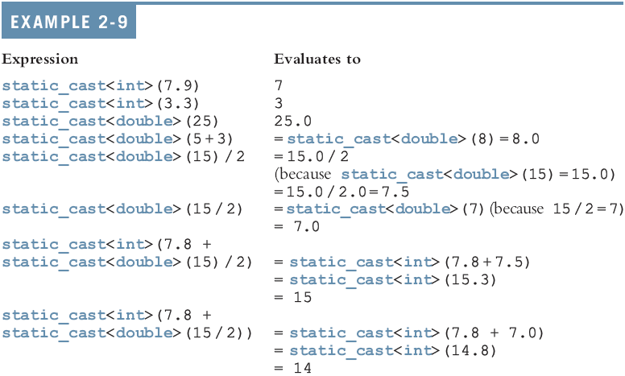
Type Conversion (continued)

Slide 38
string Type
Programmer-defined type supplied in ANSI/ISO Standard C++ library
Sequence of zero or more characters
Enclosed in double quotation marks
Null: a string with no characters
Each character has relative position in string
Position of first character is 0
Length of a string is number of characters in it
Example: length of "William Jacob" is 13

Slide 39
Input
Data must be loaded into main memory before it can be manipulated
Storing data in memory is a two-step process:
Instruct computer to allocate memory
Include statements to put data into memory

Slide 40

Allocating Memory with Constants and Variables
Named constant: memory location whose content can’t change during execution
The syntax to declare a named constant is:
In C++, const is a reserved word

Slide 41
Allocating Memory with Constants and Variables (continued)
Variable: memory location whose content may change during execution
The syntax to declare a variable is:

Slide 42
Putting Data into Variables
Ways to place data into a variable:
Use C++’s assignment statement
Use input (read) statements

Slide 43
Assignment Statement
The assignment statement takes the form:
Expression is evaluated and its value is assigned to the variable on the left side
In C++, = is called the assignment operator

Slide 44
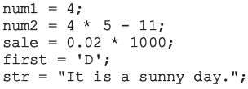
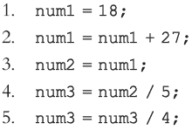
Assignment Statement (continued)

Slide 45
Saving and Using the Value of an Expression
To save the value of an expression:
Declare a variable of the appropriate data type
Assign the value of the expression to the variable that was declared
Use the assignment statement
Wherever the value of the expression is needed, use the variable holding the value

Slide 46
Declaring & Initializing Variables
Variables can be initialized when declared:
int first=13, second=10;
char ch=' ';
double x=12.6;
All variables must be initialized before they are used
But not necessarily during declaration

Slide 47

Input (Read) Statement
cin is used with >> to gather input
The stream extraction operator is >>
For example, if miles is a double variable
cin >> miles;
Causes computer to get a value of type double
Places it in the variable miles

Slide 48
Input (Read) Statement (continued)
Using more than one variable in cin allows more than one value to be read at a time
For example, if feet and inches are variables of type int, a statement such as:
cin >> feet >> inches;
Inputs two integers from the keyboard
Places them in variables feet and inches respectively

Slide 49
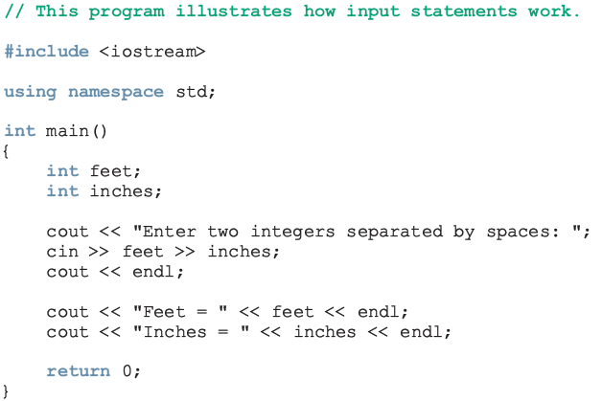
Input (Read) Statement (continued)

Slide 50
Variable Initialization
There are two ways to initialize a variable:
int feet;
By using the assignment statement
feet = 35;
By using a read statement
cin >> feet;

Slide 51
Increment & Decrement Operators
Increment operator: increment variable by 1
Pre-increment: ++variable
Post-increment: variable++
Decrement operator: decrement variable by 1
Pre-decrement: --variable
Post-decrement: variable—
What is the difference between the following?
x = 5;
y = ++x;
x = 5;
y = x++;

Slide 52
Output
The syntax of cout and << is:
Called an output statement
The stream insertion operator is <<
Expression evaluated and its value is printed at the current cursor position on the screen

Slide 53
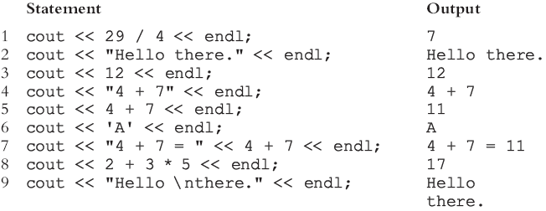
Output (continued)
A manipulator is used to format the output
Example: endl causes insertion point to move to beginning of next line

Slide 54
Output (continued)
The new line character is '\n'
May appear anywhere in the string
cout << "Hello there.";
cout << "My name is James.";
Output:
Hello there.My name is James.
cout << "Hello there.\n";
cout << "My name is James.";
Output :
Hello there.
My name is James.

Slide 55
Output (continued)

Slide 56
Preprocessor Directives
C++ has a small number of operations
Many functions and symbols needed to run a C++ program are provided as collection of libraries
Every library has a name and is referred to by a header file
Preprocessor directives are commands supplied to the preprocessor
All preprocessor commands begin with #
No semicolon at the end of these commands

Slide 57
Preprocessor Directives (continued)
Syntax to include a header file:
For example:
#include <iostream>
Causes the preprocessor to include the header file iostream in the program

Slide 58
namespace and Using cin and cout in a Program
cin and cout are declared in the header file iostream, but within std namespace
To use cin and cout in a program, use the following two statements:
#include <iostream>
using namespace std;

Slide 59
Using the string Data Type in a Program
To use the string type, you need to access its definition from the header file string
Include the following preprocessor directive:
#include <string>

Slide 60
Creating a C++ Program
C++ program has two parts:
Preprocessor directives
The program
Preprocessor directives and program statements constitute C++ source code (.cpp)
Compiler generates object code (.obj)
Executable code is produced and saved in a file with the file extension .exe

Slide 61
Creating a C++ Program (continued)
A C++ program is a collection of functions, one of which is the function main
The first line of the function main is called the heading of the function:
int main()
The statements enclosed between the curly braces ({ and }) form the body of the function
Contains two types of statements:
Declaration statements
Executable statements

Slide 62
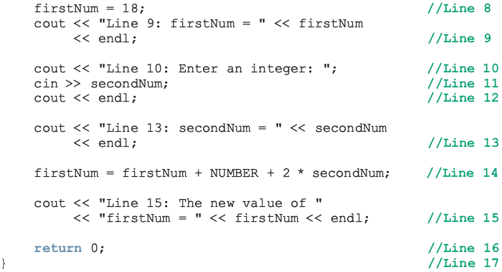

Slide 63
Creating a C++ Program (continued)
Sample Run:
Line 9: firstNum = 18
Line 10: Enter an integer: 15
Line 13: secondNum = 15
Line 15: The new value of firstNum = 60

Slide 64
Program Style and Form
Every C++ program has a function main
It must also follow the syntax rules
Other rules serve the purpose of giving precise meaning to the language

Slide 65
Syntax
Errors in syntax are found in compilation
int x; //Line 1
int y //Line 2: error
double z; //Line 3
y = w + x; //Line 4: error

Slide 66
Use of Blanks
In C++, you use one or more blanks to separate numbers when data is input
Used to separate reserved words and identifiers from each other and from other symbols
Must never appear within a reserved word or identifier

Slide 67
Use of Semicolons, Brackets, and Commas
All C++ statements end with a semicolon
Also called a statement terminator
{ and } are not C++ statements
Commas separate items in a list

Slide 68
Semantics
Possible to remove all syntax errors in a program and still not have it run
Even if it runs, it may still not do what you meant it to do
For example,
2 + 3 * 5 and (2 + 3) * 5
are both syntactically correct expressions, but have different meanings

Slide 69
Naming Identifiers
Identifiers can be self-documenting:
CENTIMETERS_PER_INCH
Avoid run-together words :
annualsale
Solution:
Capitalize the beginning of each new word
annualSale
Inserting an underscore just before a new word
annual_sale

Slide 70
Prompt Lines
Prompt lines: executable statements that inform the user what to do
cout << "Please enter a number between 1 and 10 and "
<< "press the return key" << endl;
cin >> num;

Slide 71
Documentation
A well-documented program is easier to understand and modify
You use comments to document programs
Comments should appear in a program to:
Explain the purpose of the program
Identify who wrote it
Explain the purpose of particular statements

Slide 72
Form and Style
Consider two ways of declaring variables:
Method 1
int feet, inch;
double x, y;
Method 2
int a,b;double x,y;
Both are correct; however, the second is hard to read

Slide 73
More on Assignment Statements
C++ has special assignment statements called compound assignments
+=, -=, *=, /=, and %=
Example:
x *= y;

Slide 74
Programming Example: Convert Length
Write a program that takes as input a given length expressed in feet and inches
Convert and output the length in centimeters
Input: length in feet and inches
Output: equivalent length in centimeters
Lengths are given in feet and inches
Program computes the equivalent length in centimeters
One inch is equal to 2.54 centimeters

Slide 75
Programming Example: Convert Length (continued)
Convert the length in feet and inches to all inches:
Multiply the number of feet by 12
Add given inches
Use the conversion formula (1 inch = 2.54 centimeters) to find the equivalent length in centimeters
The algorithm is as follows:
Get the length in feet and inches
Convert the length into total inches
Convert total inches into centimeters
Output centimeters

Slide 76
Programming Example: Variables and Constants
Variables
int feet; //variable to hold given feet
int inches; //variable to hold given inches
int totalInches; //variable to hold total inches
double centimeters; //variable to hold length in
//centimeters
Named Constant
const double CENTIMETERS_PER_INCH = 2.54;
const int INCHES_PER_FOOT = 12;

Slide 77
Programming Example: Main Algorithm
Prompt user for input
Get data
Echo the input (output the input)
Find length in inches
Output length in inches
Convert length to centimeters
Output length in centimeters

Slide 78
Programming Example: Putting It Together
Program begins with comments
System resources will be used for I/O
Use input statements to get data and output statements to print results
Data comes from keyboard and the output will display on the screen
The first statement of the program, after comments, is preprocessor directive to include header file iostream

Slide 79
Programming Example: Putting It Together (continued)
Two types of memory locations for data manipulation:
Named constants
Usually put before main
Variables
This program has only one function (main), which will contain all the code
The program needs variables to manipulate data, which are declared in main

Slide 80
Programming Example: Body of the Function
The body of the function main has the following form:
int main ()
{
declare variables
statements
return 0;
}

Slide 81
Programming Example: Writing a Complete Program
Begin the program with comments for documentation
Include header files
Declare named constants, if any
Write the definition of the function main

Slide 82
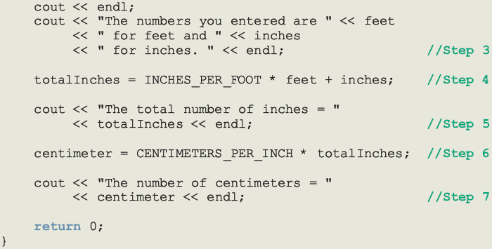

Slide 83
Programming Example: Sample Run
Enter two integers, one for feet, one for inches: 15 7
The numbers you entered are 15 for feet and 7 for inches.
The total number of inches = 187
The number of centimeters = 474.98

Slide 84
Summary
C++ program: collection of functions where each program has a function called main
Identifier consists of letters, digits, and underscores, and begins with letter or underscore
The arithmetic operators in C++ are addition (+), subtraction (-),multiplication (*), division (/), and modulus (%)
Arithmetic expressions are evaluated using the precedence associativity rules

Slide 85
Summary (continued)
All operands in an integral expression are integers and all operands in a floating-point expression are decimal numbers
Mixed expression: contains both integers and decimal numbers
Use the cast operator to explicitly convert values from one data type to another
A named constant is initialized when declared
All variables must be declared before used

Slide 86
Summary (continued)
Use cin and stream extraction operator >> to input from the standard input device
Use cout and stream insertion operator << to output to the standard output device
Preprocessor commands are processed before the program goes through the compiler
A file containing a C++ program usually ends with the extension .cpp

Slide 87
Control Structures I (Selection)

Slide 88
Objectives
In this chapter, you will:
Learn about control structures
Examine relational and logical operators
Explore how to form and evaluate logical (Boolean) expressions
Discover how to use the selection control structures if, if...else, and switch in a program
Learn to use the assert function to terminate a program

Slide 89
Control Structures
A computer can proceed:
In sequence
Selectively (branch) - making a choice
Repetitively (iteratively) - looping
Some statements are executed only if certain conditions are met
A condition is met if it evaluates to true

Slide 90
Control Structures (continued)

Slide 91
Relational Operators
A condition is represented by a logical (Boolean) expression that can be true or false
Relational operators:
Allow comparisons
Require two operands (binary)
Evaluate to true or false

Slide 92
Relational Operators (continued)

Slide 93
Relational Operators and Simple Data Types
You can use the relational operators with all three simple data types:
8 < 15 evaluates to true
6 != 6 evaluates to false
2.5 > 5.8 evaluates to false
5.9 <= 7.5 evaluates to true

Slide 94
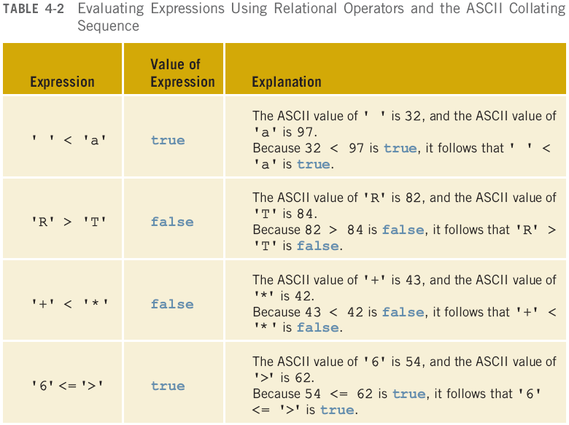
Comparing Characters

Slide 95
Relational Operators and the string Type
Relational operators can be applied to strings
Strings are compared character by character, starting with the first character
Comparison continues until either a mismatch is found or all characters are found equal
If two strings of different lengths are compared and the comparison is equal to the last character of the shorter string
The shorter string is less than the larger string

Slide 96
Relational Operators and the string Type (continued)
Suppose we have the following declarations:
string str1 = "Hello";
string str2 = "Hi";
string str3 = "Air";
string str4 = "Bill";
string str4 = "Big";

Slide 97
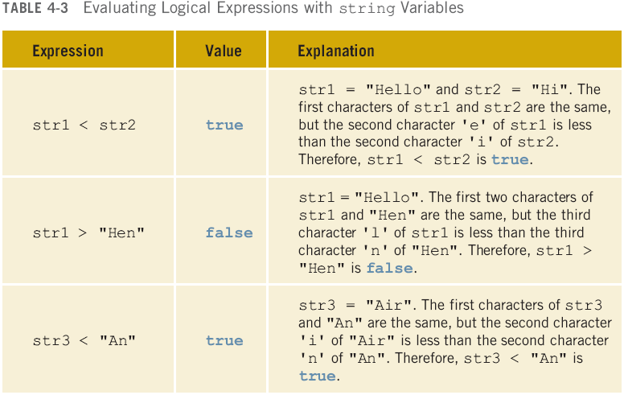
Relational Operators and the string Type (continued)

Slide 98
Relational Operators and the string Type (continued)

Slide 99
Relational Operators and the string Type (continued)

Slide 100
Logical (Boolean) Operators and Logical Expressions
Logical (Boolean) operators enable you to combine logical expressions
unary
binary
binary

Slide 101
Logical (Boolean) Operators and Logical Expressions (continued)

Slide 102
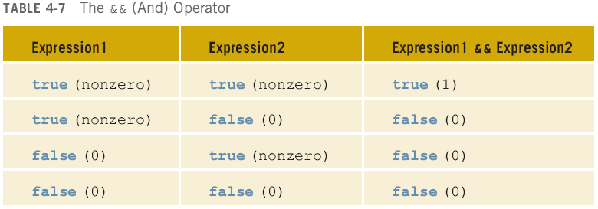

Slide 103
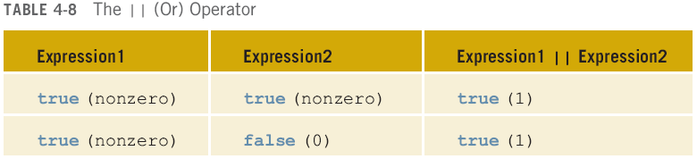
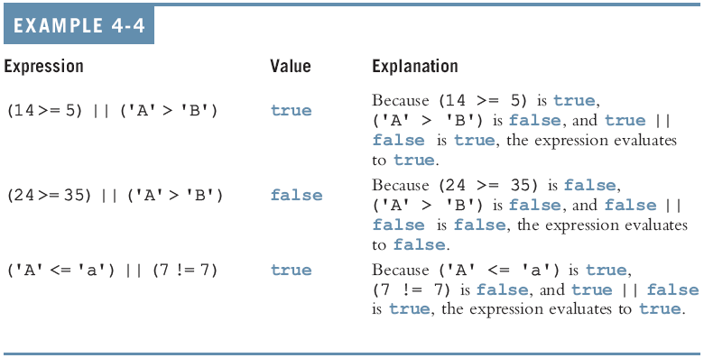

Slide 104
Order of Precedence
Relational and logical operators are evaluated from left to right
The associativity is left to right
Parentheses can override precedence

Slide 105
Order of Precedence (continued)

Slide 106
Order of Precedence (continued)

Slide 107
Order of Precedence (continued)

Slide 108
Short-Circuit Evaluation
Short-circuit evaluation: evaluation of a logical expression stops as soon as the value of the expression is known
Example:
(age >= 21) || ( x == 5) //Line 1
(grade == 'A') && (x >= 7) //Line 2

Slide 109
int Data Type and Logical (Boolean) Expressions
Earlier versions of C++ did not provide built-in data types that had Boolean values
Logical expressions evaluate to either 1 or 0
The value of a logical expression was stored in a variable of the data type int
You can use the int data type to manipulate logical (Boolean) expressions

Slide 110
The bool Data Type and Logical (Boolean) Expressions
The data type bool has logical (Boolean) values true and false
bool, true, and false are reserved words
The identifier true has the value 1
The identifier false has the value 0

Slide 111
Logical (Boolean) Expressions
Logical expressions can be unpredictable
The following expression appears to represent a comparison of 0, num, and 10:
0 <= num <= 10
It always evaluates to true because 0 <= num evaluates to either 0 or 1, and 0 <= 10 is true and 1 <= 10 is true
A correct way to write this expression is:
0 <= num && num <= 10

Slide 112
Selection: if and if...else
One-Way Selection
Two-Way Selection
Compound (Block of) Statements
Multiple Selections: Nested if
Comparing if...else Statements with a Series of if Statements

Slide 113
Selection: if and if...else (continued)
Using Pseudocode to Develop, Test, and Debug a Program
Input Failure and the if Statement
Confusion Between the Equality Operator (==) and the Assignment Operator (=)
Conditional Operator (?:)

Slide 114
One-Way Selection
The syntax of one-way selection is:
The statement is executed if the value of the expression is true
The statement is bypassed if the value is false; program goes to the next statement
if is a reserved word

Slide 115
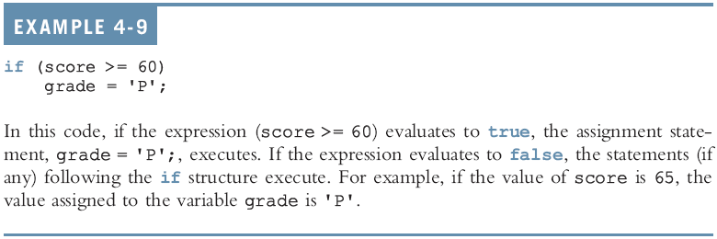
One-Way Selection (continued)

Slide 117
One-Way Selection (continued)

Slide 118
Two-Way Selection
Two-way selection takes the form:
If expression is true, statement1 is executed; otherwise, statement2 is executed
statement1 and statement2 are any C++ statements
else is a reserved word

Slide 119
Two-Way Selection (continued)

Slide 120
Two-Way Selection (continued)

Slide 121
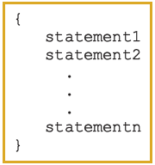
Compound (Block of) Statement
Compound statement (block of statements):
A compound statement is a single statement

Slide 122
Compound (Block of) Statement (continued)
if (age > 18)
{
cout << "Eligible to vote." << endl;
cout << "No longer a minor." << endl;
}
else
{
cout << "Not eligible to vote." << endl;
cout << "Still a minor." << endl;
}

Slide 123
Multiple Selections: Nested if
Nesting: one control statement in another
An else is associated with the most recent if that has not been paired with an else

Slide 125
Multiple Selections: Nested if (continued)

Slide 126
Comparing if…else Statements with a Series of if Statements

Slide 127
Using Pseudocode to Develop, Test, and Debug a Program
Pseudocode (pseudo): provides a useful means to outline and refine a program before putting it into formal C++ code
You must first develop a program using paper and pencil
On paper, it is easier to spot errors and improve the program
Especially with large programs

Slide 128
Input Failure and the if Statement
If input stream enters a fail state
All subsequent input statements associated with that stream are ignored
Program continues to execute
May produce erroneous results
Can use if statements to check status of input stream
If stream enters the fail state, include instructions that stop program execution

Slide 129
Confusion Between == and =
C++ allows you to use any expression that can be evaluated to either true or false as an expression in the if statement:
if (x = 5)
cout << "The value is five." << endl;
The appearance of = in place of == resembles a silent killer
It is not a syntax error
It is a logical error

Slide 130
Conditional Operator (?:)
Conditional operator (?:) takes three arguments
Ternary operator
Syntax for using the conditional operator:
expression1 ? expression2 : expression3
If expression1 is true, the result of the conditional expression is expression2
Otherwise, the result is expression3

Slide 131
switch Structures
switch structure: alternate to if-else
switch (integral) expression is evaluated first
Value of the expression determines which corresponding action is taken
Expression is sometimes called the selector

Slide 132
switch Structures (continued)
One or more statements may follow a case label
Braces are not needed to turn multiple statements into a single compound statement
The break statement may or may not appear after each statement
switch, case, break, and default are reserved words

Slide 134
Programming Example: Cable Company Billing
This programming example calculates a customer’s bill for a local cable company
There are two types of customers:
Residential
Business
Two rates for calculating a cable bill:
One for residential customers
One for business customers

Slide 135
Programming Example: Rates
For residential customer:
Bill processing fee: $4.50
Basic service fee: $20.50
Premium channel: $7.50 per channel
For business customer:
Bill processing fee: $15.00
Basic service fee: $75.00 for first 10 connections and $5.00 for each additional connection
Premium channel cost: $50.00 per channel for any number of connections

Slide 136
Programming Example: Requirements
Ask user for account number and customer code
Assume R or r stands for residential customer and B or b stands for business customer

Slide 137
Programming Example: Input and Output
Input:
Customer account number
Customer code
Number of premium channels
For business customers, number of basic service connections
Output:
Customer’s account number
Billing amount

Slide 138
Programming Example: Program Analysis
Purpose: calculate and print billing amount
Calculating billing amount requires:
Customer for whom the billing amount is calculated (residential or business)
Number of premium channels to which the customer subscribes
For a business customer, you need:
Number of basic service connections
Number of premium channels

Slide 139
Programming Example: Program Analysis (continued)
Data needed to calculate the bill, such as bill processing fees and the cost of a premium channel, are known quantities
The program should print the billing amount to two decimal places

Slide 140
Programming Example: Algorithm Design
Set precision to two decimal places
Prompt user for account number and customer type
If customer type is R or r
Prompt user for number of premium channels
Compute and print the bill
If customer type is B or b
Prompt user for number of basic service connections and number of premium channels
Compute and print the bill

Slide 141
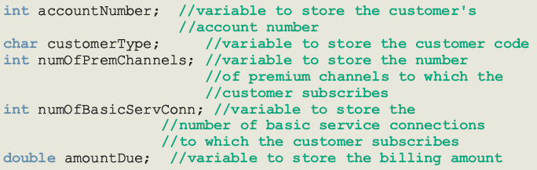
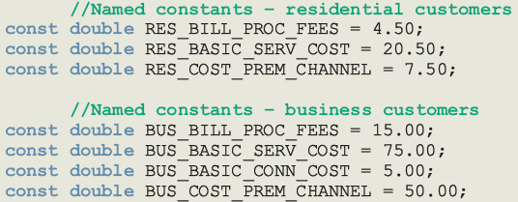
Programming Example: Variables and Named Constants

Slide 142
Programming Example: Formulas
Billing for residential customers:
amountDue = RES_BILL_PROC_FEES +
RES_BASIC_SERV_COST
+ numOfPremChannels *
RES_COST_PREM_CHANNEL;

Slide 143
Programming Example: Formulas (continued)
Billing for business customers:
if (numOfBasicServConn <= 10)
amountDue = BUS_BILL_PROC_FEES +
BUS_BASIC_SERV_COST
+ numOfPremChannels *
BUS_COST_PREM_CHANNEL;
else
amountDue = BUS_BILL_PROC_FEES +
BUS_BASIC_SERV_COST
+ (numOfBasicServConn - 10)
* BUS_BASIC_CONN_COST
+ numOfPremChannels *
BUS_COST_PREM_CHANNEL;

Slide 144
Programming Example: Main Algorithm
Output floating-point numbers in fixed decimal with decimal point and trailing zeros
Output floating-point numbers with two decimal places and set the precision to two decimal places
Prompt user to enter account number
Get customer account number
Prompt user to enter customer code
Get customer code

Slide 145
Programming Example: Main Algorithm (continued)
If the customer code is r or R,
Prompt user to enter number of premium channels
Get the number of premium channels
Calculate the billing amount
Print account number and billing amount

Slide 146
Programming Example: Main Algorithm (continued)
If customer code is b or B,
Prompt user to enter number of basic service connections
Get number of basic service connections
Prompt user to enter number of premium channels
Get number of premium channels
Calculate billing amount
Print account number and billing amount

Slide 147
Programming Example: Main Algorithm (continued)
If customer code is other than r, R, b, or B, output an error message

Slide 148
Summary
Control structures alter normal control flow
Most common control structures are selection and repetition
Relational operators: ==, <, <=, >, >=, !=
Logical expressions evaluate to 1 (true) or 0 (false)
Logical operators: ! (not), && (and), || (or)

Slide 149
Summary (continued)
Two selection structures: one-way selection and two-way selection
The expression in an if or if...else structure is usually a logical expression
No stand-alone else statement in C++
Every else has a related if
A sequence of statements enclosed between braces, { and }, is called a compound statement or block of statements

Slide 150
Summary (continued)
Using assignment in place of the equality operator creates a semantic error
switch structure handles multiway selection
break statement ends switch statement
Use assert to terminate a program if certain conditions are not met

Slide 151
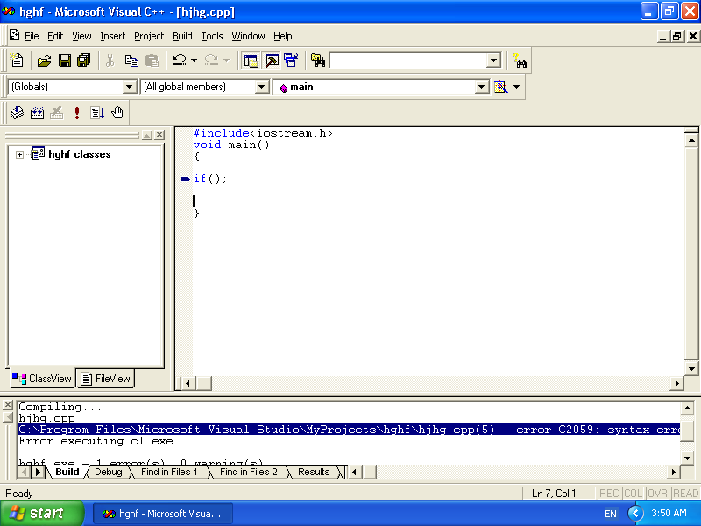

Slide 152
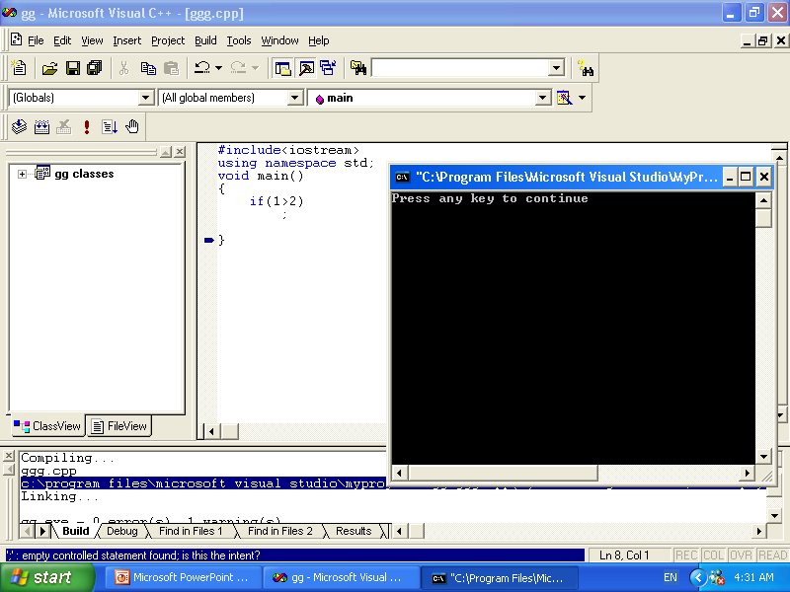

Slide 153
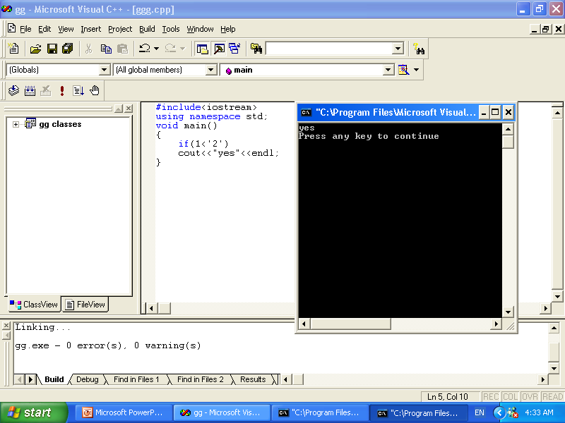

Slide 154
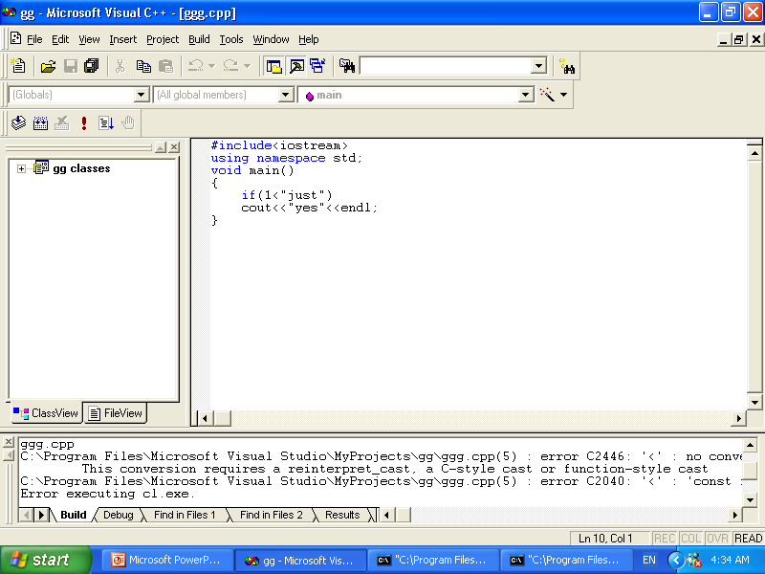

Slide 155
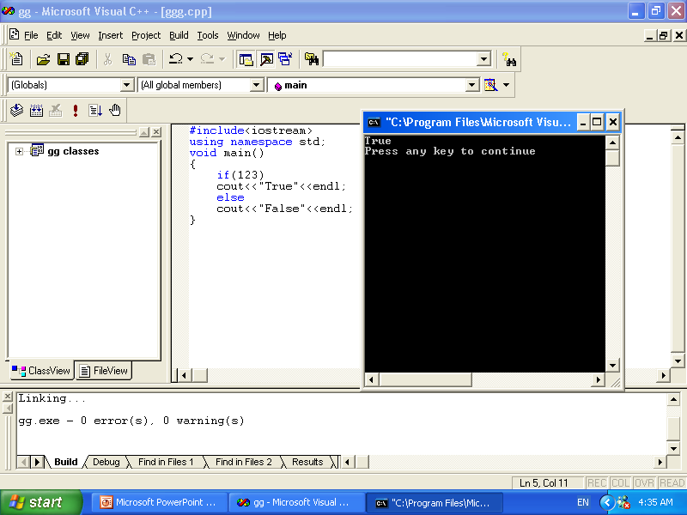

Slide 156
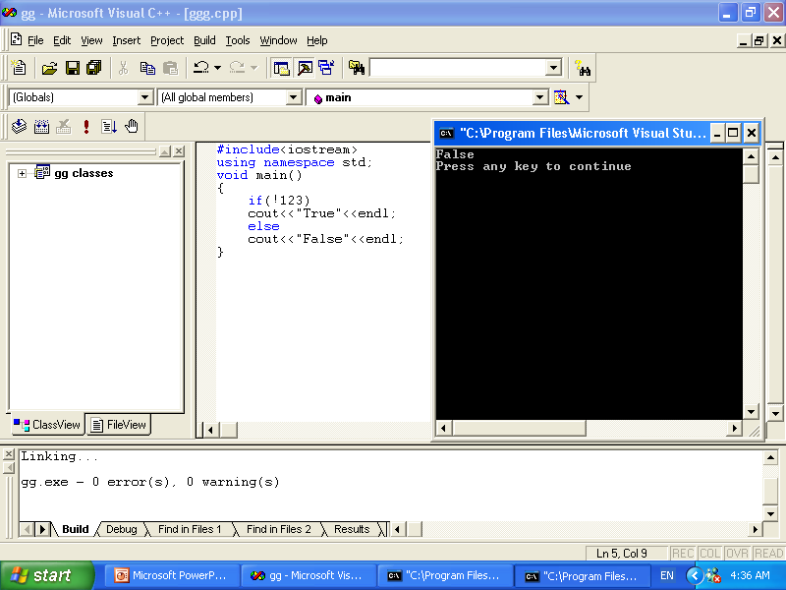

Slide 157
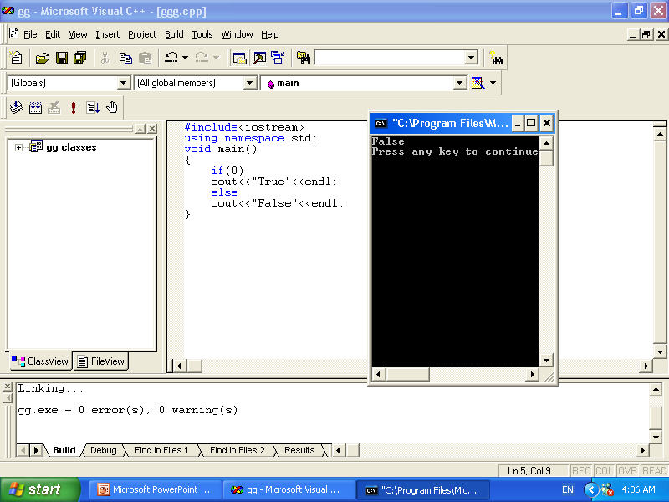

Slide 158
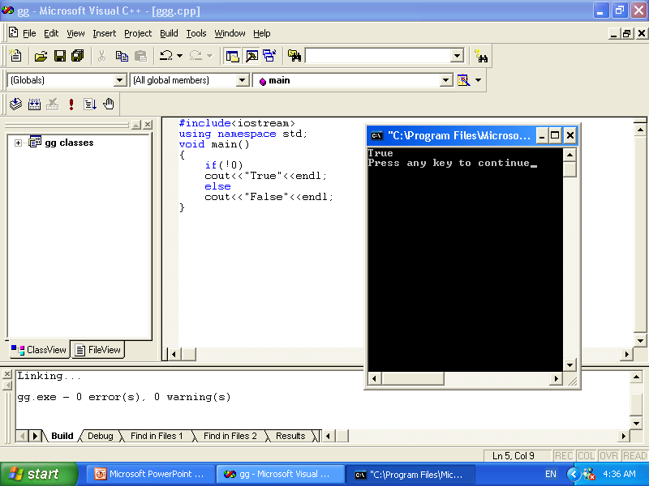

Slide 159
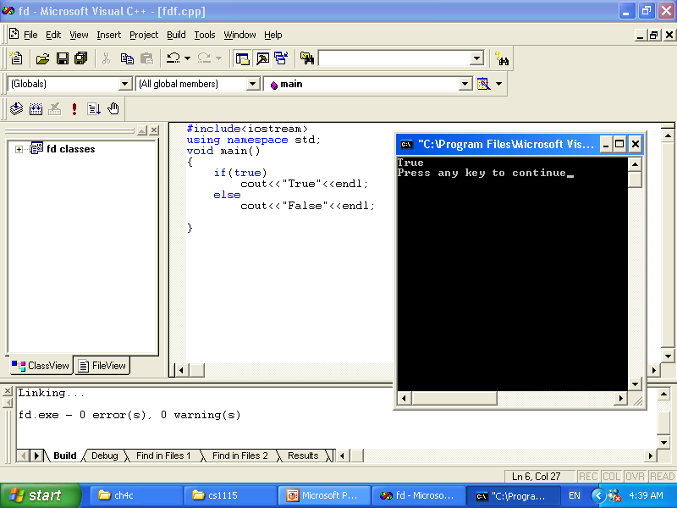

Slide 160
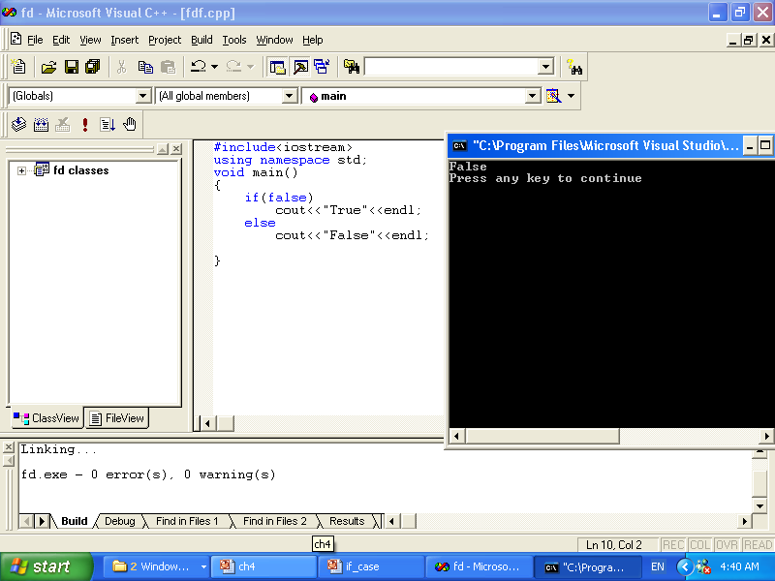

Slide 161
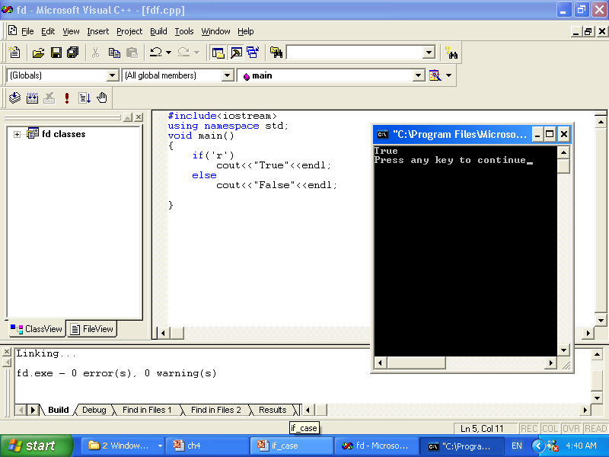

Slide 162
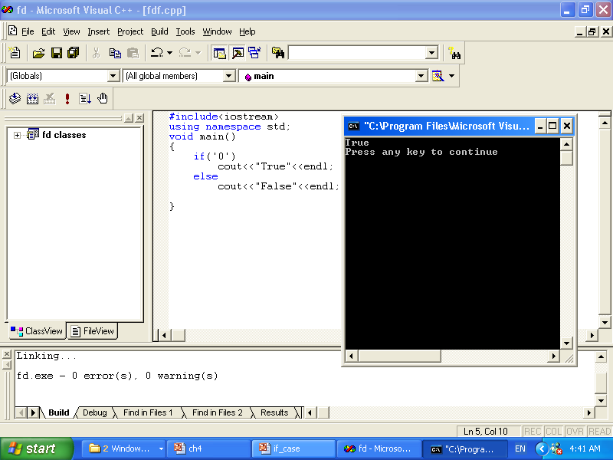

Slide 163
Conditional Operator (?:)
Conditional operator (?:) takes three arguments (ternary)
Syntax for using the conditional operator:
expression1 ? expression2 : expression3
If expression1 is true, the result of the conditional expression is expression2. Otherwise, the result is expression3

Slide 164
Conditional Operator (?:)
if(a>=b)
Max=a;
else
Max=b;
*******************
Max=(a>=b)?a:b;

Slide 165
switch ( test )
{
case 1 : // Process for test = 1 ...
break;
case 5 : // Process for test = 5 ...
break;
default : // Process for all other cases.
}

Slide 166
switch works as follows:-
The expression, just test in this case, is evaluated.
The case labels are checked in turn for the one that matches the value.
If none matches, and the optional default label exists, it is selected,
the break statement is normally added before the next case label to transfer control out of the switch statement.

Slide 167
#include <iostream>
using namespace std;
int main()
{
char grade;
cout << "Enter your grade: ";
cin >> grade;
cout << endl;
switch (grade)
{
case 'A':
cout << "Your grade is A." << endl;
break;
case 'B':
cout << "Your grade is B." << endl;
break;
case 'C':
cout << "Your grade is C." << endl;
break;
case 'F':
cout << "Your grade is F." << endl;
break;
default:
cout<<" The grade is invalid."<<endl;
}
return 0;
}

Slide 168
switch with break
#include <iostream>
using namespace std;
int main()
{
Int place ;
cout << "Enter your place : ";
cin >> place;
cout << endl;
switch (place)
{
case 1: cout << "we're first" << endl;
break;
case 2: cout << "we're second" << endl; break;
default:
cout << "we're not first or second" << endl;
}
return 0;
}

Slide 169
switch with break
#include <iostream>
using namespace std;
int main()
{
int place ;
cout << "Enter your place : ";
cin >> place;
cout << endl;
switch (place)
{
case 1: cout << "we're first" << endl;
break;
case 2: cout << "we're second" << endl;
break;
default:
cout << "we're not first or second" << endl;
}
cout<<endl<<endl;
return 0;
}

Slide 170
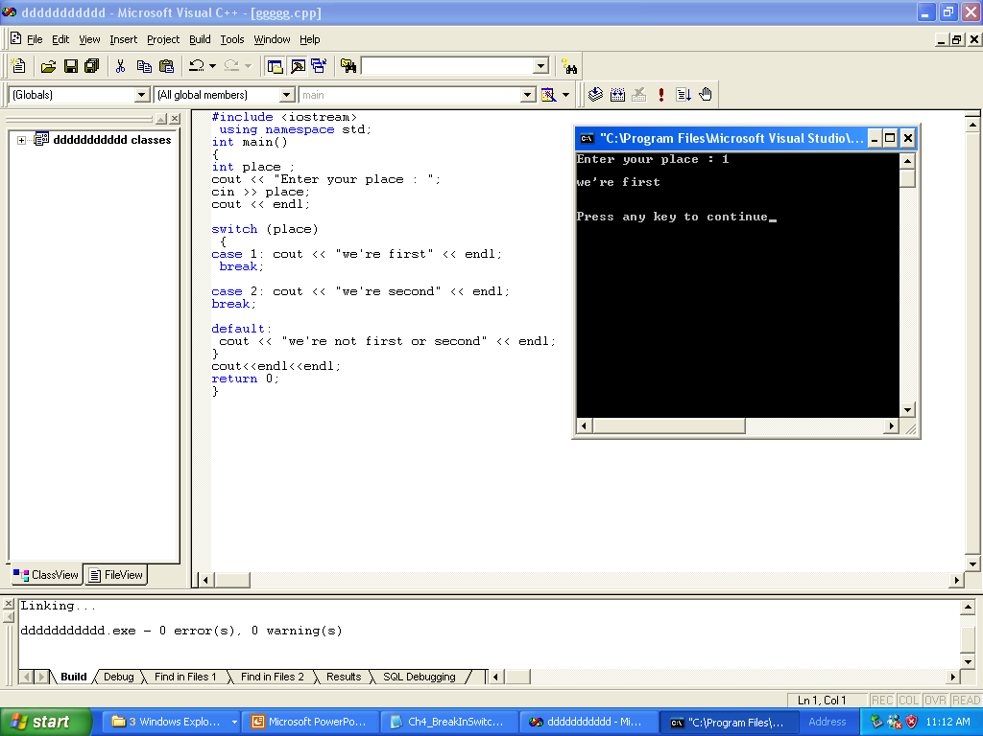
switch with break

Slide 171
switch without break
#include <iostream>
using namespace std;
int main()
{
int place ;
cout << "Enter your place : ";
cin >> place;
cout << endl;
switch (place)
{
case 1: cout << "we're first" << endl;
case 2: cout << "we're second" << endl;
default:
cout << "we're not first or second" << endl;
}
cout<<endl<<endl;
return 0;
}

Slide 172
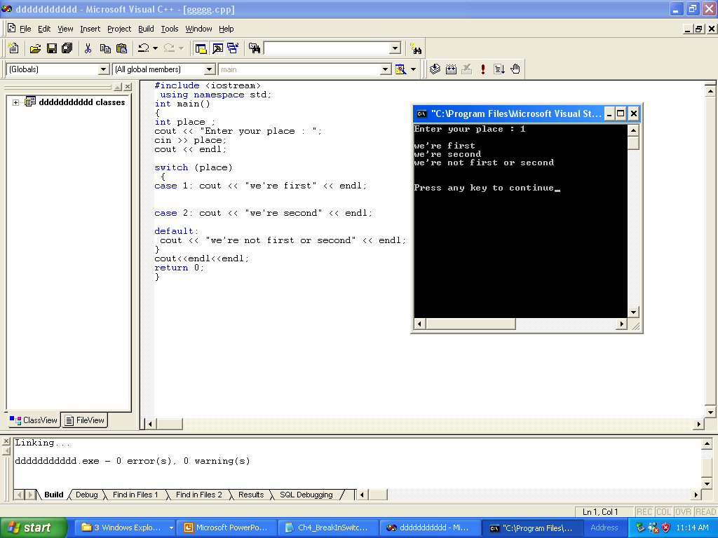

Slide 173
What is the output
#include <iostream>
using namespace std;
int main()
{
int place ;
cout << "Enter your place : ";
cin >> place;
cout << endl;
switch (place)
{
case 1: cout << "we're first" << endl;
case 1: cout << "we're second" << endl;
default:
cout << "we're not first or second" << endl;
}
cout<<endl<<endl;
return 0;
}

Slide 174
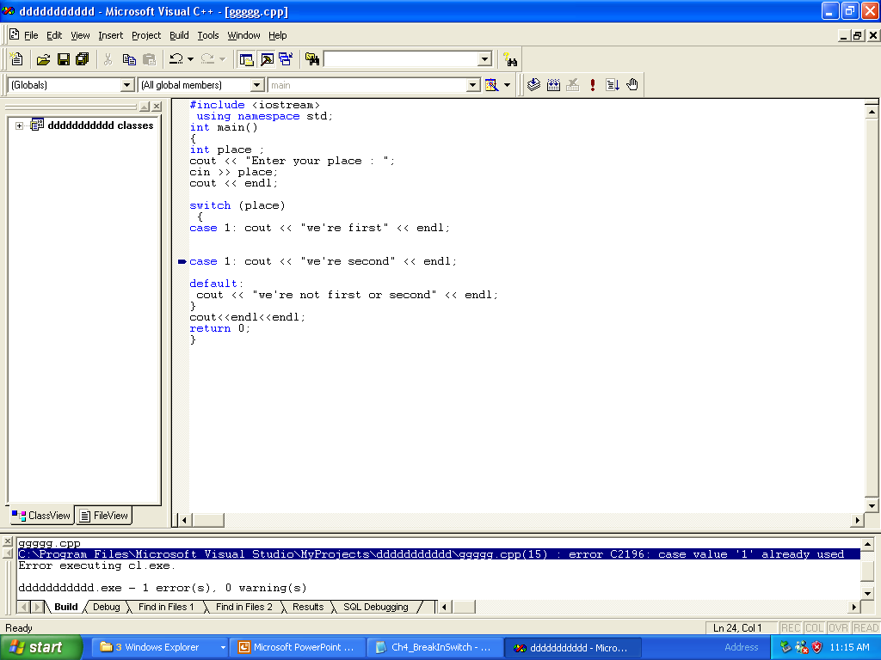

Slide 175
assert
q=n/d;
If d is 0,the program would terminate with error message stating that an illegal operation has occurred
Solution:
assert(d);
q=n/d
You need preprocessor directive #include<cassert>
Assert statement identifies the expression where assertion failed ,the name of file containing the source code ,and the line number where the assertion failed

Slide 176
Control Structures II (Repetition)

Slide 177
Objectives
In this chapter, you will:
Learn about repetition (looping) control structures
Explore how to construct and use count-controlled, sentinel-controlled, flag-controlled, and EOF-controlled repetition structures
Examine break and continue statements
Discover how to form and use nested control structures

Slide 178
Why Is Repetition Needed?
Repetition allows you to efficiently use variables
Can input, add, and average multiple numbers using a limited number of variables
For example, to add five numbers:
Declare a variable for each number, input the numbers and add the variables together
Create a loop that reads a number into a variable and adds it to a variable that contains the sum of the numbers

Slide 179
while Looping (Repetition) Structure
The general form of the while statement is:
while is a reserved word
Statement can be simple or compound
Expression acts as a decision maker and is usually a logical expression
Statement is called the body of the loop
The parentheses are part of the syntax

Slide 180
while Looping (Repetition) Structure (continued)
Infinite loop: continues to execute endlessly
Avoided by including statements in loop body that assure exit condition is eventually false

Slide 181
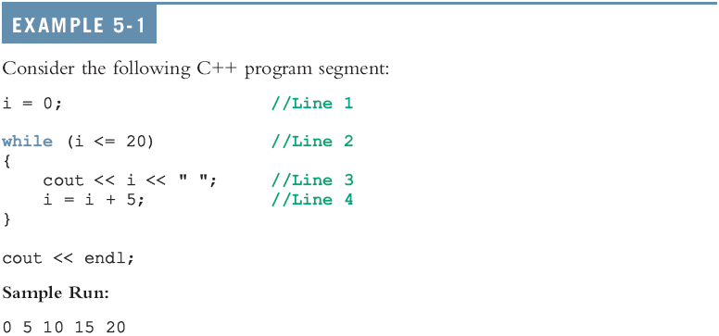
while Looping (Repetition) Structure (continued)

Slide 182
Designing while Loops

Slide 183
Case 1: Counter-Controlled while Loops
If you know exactly how many pieces of data need to be read, the while loop becomes a counter-controlled loop

Slide 184
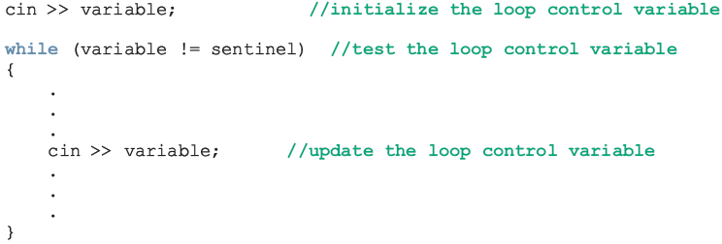
Case 2: Sentinel-Controlled while Loops
Sentinel variable is tested in the condition and loop ends when sentinel is encountered

Slide 185
Telephone Digits
Example 5-5 provides an example of a sentinel-controlled loop
The program converts uppercase letters to their corresponding telephone digit

Slide 186
Case 3: Flag-Controlled while Loops
A flag-controlled while loop uses a bool variable to control the loop
The flag-controlled while loop takes the form:

Slide 187
Number Guessing Game
Example 5-6 implements a number guessing game using a flag-controlled while loop
The program uses the function rand of the header file cstdlib to generate a random number
rand() returns an int value between 0 and 32767
To convert it to an integer greater than or equal to 0 and less than 100:
rand() % 100

Slide 188
More on Expressions in while Statements
The expression in a while statement can be complex
For example:
while ((noOfGuesses < 5) && (!isGuessed))
{
…
}

Slide 189
Programming Example: Checking Account Balance
A local bank in your town needs a program to calculate a customer’s checking account balance at the end of each month
Data are stored in a file in the following form:
467343 23750.40
W 250.00
D 1200
W 75.00
I 120.74

Slide 190
Programming Example: Checking Account Balance (continued)
The first line of data shows the account number followed by the account balance at the beginning of the month
Thereafter each line has two entries:
Transaction code
Transaction amount
Transaction codes
W or w means withdrawal
D or d means deposit
I or i means interest paid by the bank

Slide 191
Programming Example: Checking Account Balance (continued)
Program updates balance after each transaction
During the month, if at any time the balance goes below $1000.00, a $25.00 service fee is charged

Slide 192
Programming Example: Checking Account Balance (continued)
Program prints the following information:
Account number
Balance at the beginning of the month
Balance at the end of the month
Interest paid by the bank
Total amount of deposit
Number of deposits
Total amount of withdrawal
Number of withdrawals
Service charge if any

Slide 193
Programming Example: Input and Output
Input: file consisting of data in the previous format
Output is of the following form:
Account Number: 467343
Beginning Balance: $23750.40
Ending Balance: $24611.49
Interest Paid: $366.24
Amount Deposited: $2230.50
Number of Deposits: 3
Amount Withdrawn: $1735.65
Number of Withdrawals: 6

Slide 194
Programming Example: Program Analysis
The first entry in the input file is the account number and the beginning balance
Program first reads account number and beginning balance
Thereafter, each entry in the file is of the following form:
transactionCode transactionAmount
To determine account balance, process each entry that contains transaction code and transaction amount

Slide 195
Programming Example: Program Analysis (continued)
Begin with starting balance and then update account balance after processing each entry
If transaction code is D, d, I, or i, transaction amount is added to the account balance
If the transaction code is W or w, transaction amount is subtracted from the balance
Keep separate counts of withdrawals and deposits

Slide 196
Programming Example: Analysis Algorithm
Algorithm:
Declare the variables
Initialize the variables
Get the account number and beginning balance
Get transaction code and transaction amount
Analyze transaction code and update the appropriate variables
Repeat Steps 4 and 5 for all data
Print the result

Slide 197
Programming Example: Variables and Constants

Slide 198
Programming Example: Steps
Declare variables as discussed previously
Initialize variables
isServiceCharged is initialized to false
Read the beginning balance in the variable beginningBalance from the file and initialize the variable accountBalance to the value of the variable beginningBalance
Since the data will be read from a file, you need to open input file

Slide 199
Programming Example: Steps (continued)
Get account number and starting balance
infile >> acctNumber >> beginningBalance;
Get transaction code and transaction amount
infile >> transactionCode
>> transactionAmount;
Analyze transaction code and update appropriate variables

Slide 200
Programming Example: Steps (continued)
Repeat Steps 4 and 5 until there is no more data
Since the number of entries in the input file is not known, use an EOF-controlled while loop
Print the result

Slide 201
Programming Example: Main Algorithm
Declare and initialize variables
Open input file
If input file does not exist, exit
Open output file
Output numbers in appropriate formats
Read accountNumber and beginningBalance

Slide 202
Programming Example: Main Algorithm (continued)
Set accountBalance to beginningBalance
Read transactionCode and transactionAmount
while (not end of input file)
if transactionCode is 'D' or 'd'
Add transactionAmount to accountBalance
Increment numberOfDeposits
if transactionCode is 'I' or 'i'
Add transactionAmount to accountBalance
Add transactionAmount to interestPaid

Slide 203
Programming Example: Main Algorithm (continued)
if transactionCode is 'W' or 'w'
Subtract transactionAmount from accountBalance
Increment numberOfWithdrawals
if (accountBalance < MINIMUM_BALANCE
&& !isServicedCharged)
Subtract SERVICE_CHARGE from accountBalance
Set isServiceCharged to true
if transactionCode is other than 'D', 'd', 'I', 'i', 'W', or 'w', output an error message
Output the results

Slide 204
for Looping (Repetition) Structure
The general form of the for statement is:
The initial statement, loop condition, and update statement are called for loop control statements
initial statement usually initializes a variable (called the for loop control, or for indexed, variable)
In C++, for is a reserved word

Slide 205
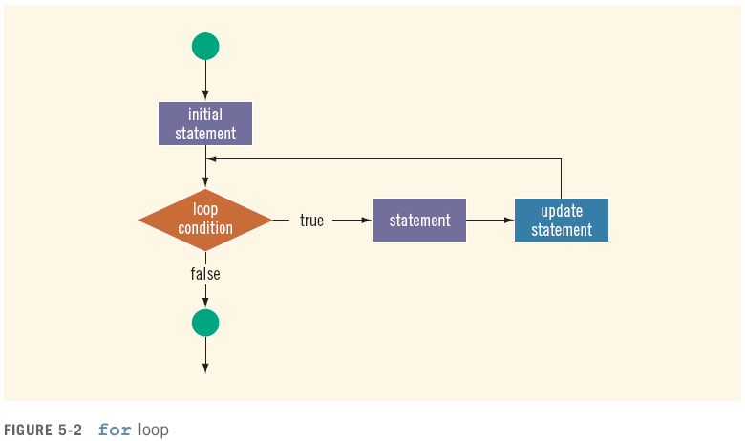
for Looping (Repetition) Structure (continued)

Slide 206
for Looping (Repetition) Structure (continued)

Slide 207
for Looping (Repetition) Structure (continued)
C++ allows you to use fractional values for loop control variables of the double type
Results may differ
The following is a semantic error:
The following is a legal for loop:
for (;;)
cout << "Hello" << endl;

Slide 208
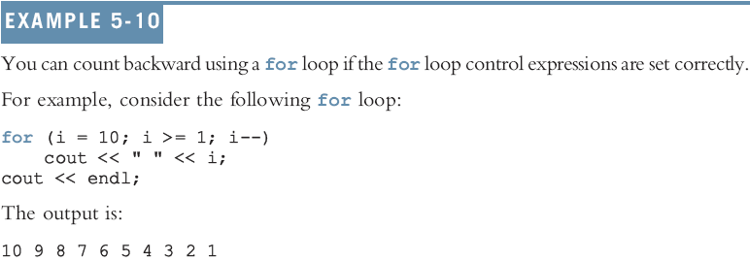
for Looping (Repetition) Structure (continued)

Slide 209

do…while Looping (Repetition) Structure
General form of a do...while:
The statement executes first, and then the expression is evaluated
To avoid an infinite loop, body must contain a statement that makes the expression false
The statement can be simple or compound
Loop always iterates at least once

Slide 210
do…while Looping (Repetition) Structure (continued)

Slide 211
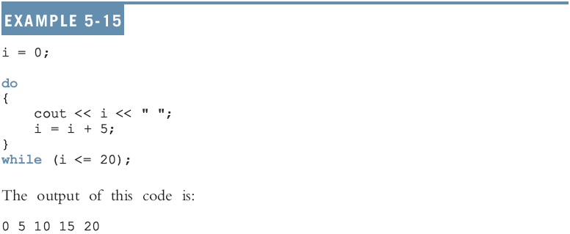
do…while Looping (Repetition) Structure (continued)

Slide 213
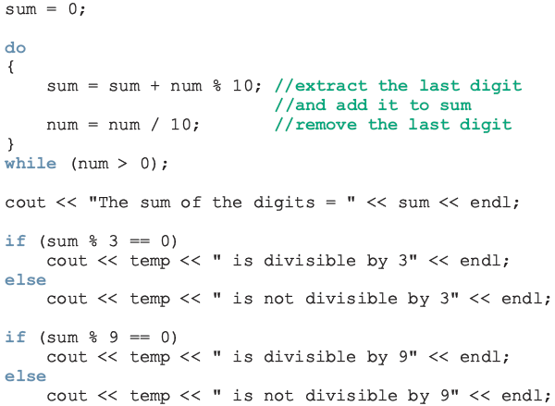
Divisibility Test by 3 and 9

Slide 214
Choosing the Right Looping Structure
All three loops have their place in C++
If you know or can determine in advance the number of repetitions needed, the for loop is the correct choice
If you do not know and cannot determine in advance the number of repetitions needed, and it could be zero, use a while loop
If you do not know and cannot determine in advance the number of repetitions needed, and it is at least one, use a do...while loop

Slide 215
break and continue Statements
break and continue alter the flow of control
break statement is used for two purposes:
To exit early from a loop
Can eliminate the use of certain (flag) variables
To skip the remainder of the switch structure
After the break statement executes, the program continues with the first statement after the structure

Slide 216
break & continue Statements (continued)
continue is used in while, for, and do…while structures
When executed in a loop
It skips remaining statements and proceeds with the next iteration of the loop

Slide 217
Nested Control Structures
To create the following pattern:
*
**
***
****
*****
We can use the following code:
for (i = 1; i <= 5 ; i++)
{
for (j = 1; j <= i; j++)
cout << "*";
cout << endl;
}

Slide 218
Nested Control Structures (continued)
What is the result if we replace the first for statement with the following?
for (i = 5; i >= 1; i--)
Answer:
*****
****
***
**
*

Slide 219
Summary
C++ has three looping (repetition) structures:
while, for, and do…while
while, for, and do are reserved words
while and for loops are called pretest loops
do...while loop is called a posttest loop
while and for may not execute at all, but do...while always executes at least once

Slide 220
Summary (continued)
while: expression is the decision maker, and the statement is the body of the loop
A while loop can be:
Counter-controlled
Sentinel-controlled
EOF-controlled
In the Windows console environment, the end-of-file marker is entered using Ctrl+z

Slide 221
Summary (continued)
for loop: simplifies the writing of a counter-controlled while loop
Putting a semicolon at the end of the for loop is a semantic error
Executing a break statement in the body of a loop immediately terminates the loop
Executing a continue statement in the body of a loop skips to the next iteration

Slide 222
What is the output
#include<iostream>
using namespace std;
void main()
{
int i;
for(i=1;i<10;i++)
{
cout<<i<<endl;
}
cout<<endl<<i<<endl;
}

Slide 223
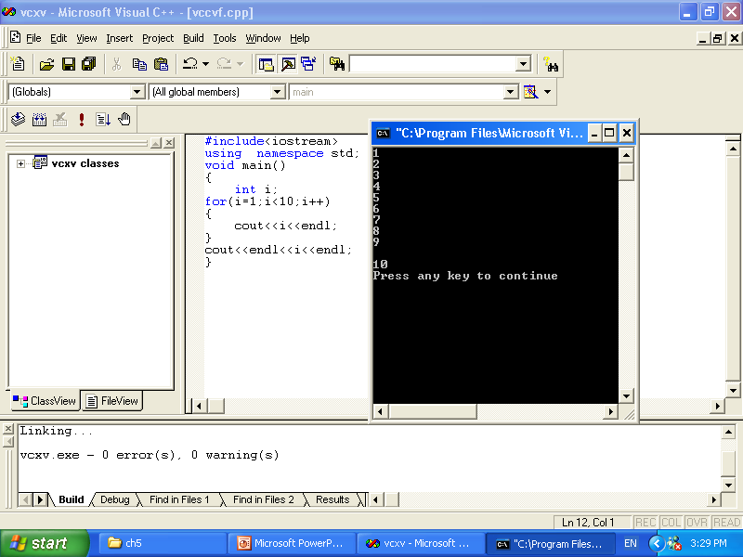

Slide 224
What is the out put
#include<iostream>
using namespace std;
void main()
{
int i;
for(i=1;i<10;++i)
{
cout<<i<<endl;
}
cout<<endl<<i<<endl;
}

Slide 225
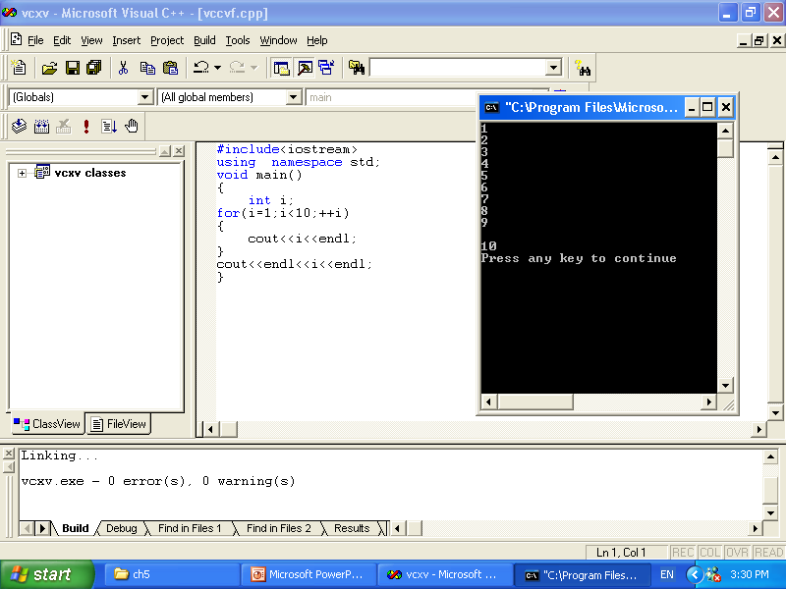

Slide 226
What is the out put
#include<iostream>
using namespace std;
void main()
{
int i;
for(;i<10;++i)
{
cout<<i<<endl;
}
cout<<endl<<i<<endl;
}

Slide 227
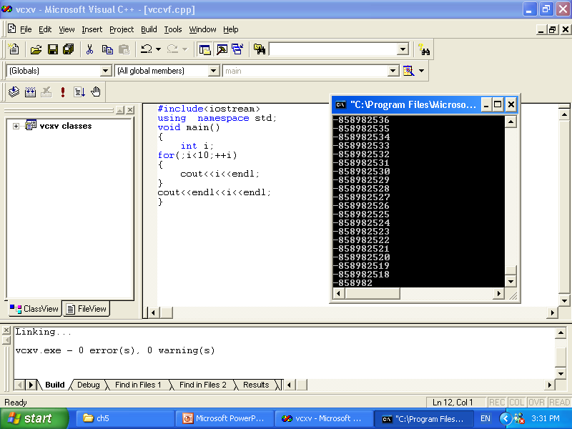
Infinite loop

Slide 228
What is the out put
#include<iostream>
using namespace std;
void main()
{
int i;
for(i=1;;++i)
{
cout<<i<<endl;
}
cout<<endl<<i<<endl;
}

Slide 229
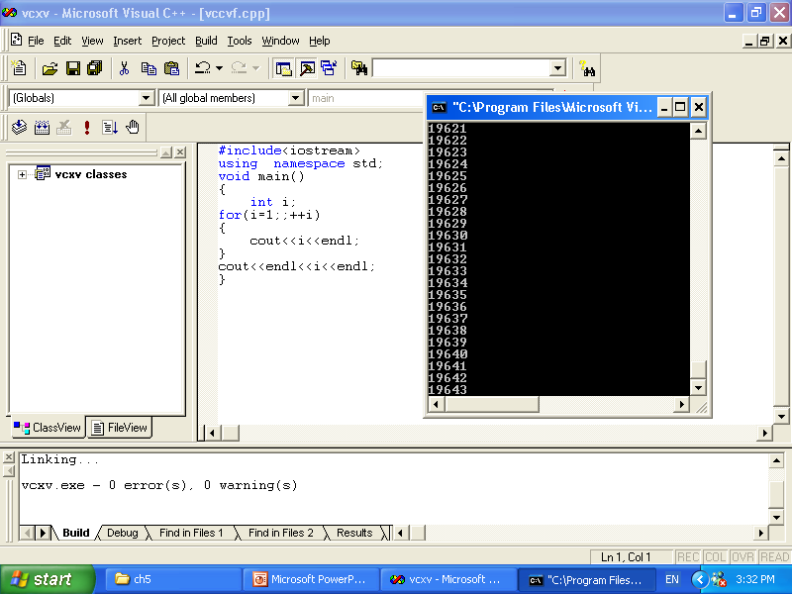
Infinite loop

Slide 230
What is the out put
#include<iostream>
using namespace std;
void main()
{
int i;
for(i=1;i<10;)
{
cout<<i<<endl;
}
cout<<endl<<i<<endl;
}

Slide 231
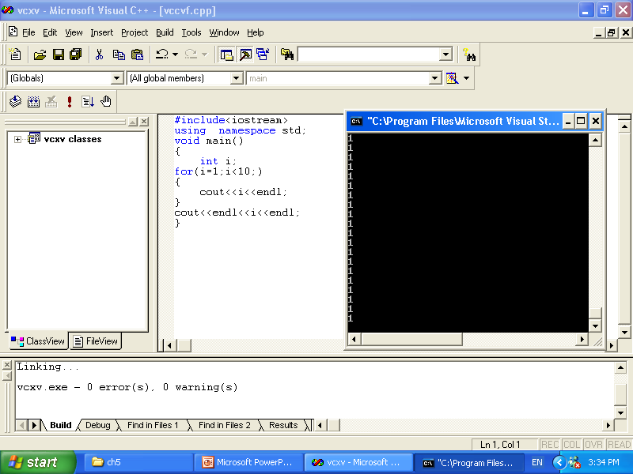
Infinite loop

Slide 232
What is the output
#include<iostream>
using namespace std;
void main()
{
int i;
for(;;)
{
cout<<i<<endl;
}
cout<<endl<<i<<endl;
}

Slide 233
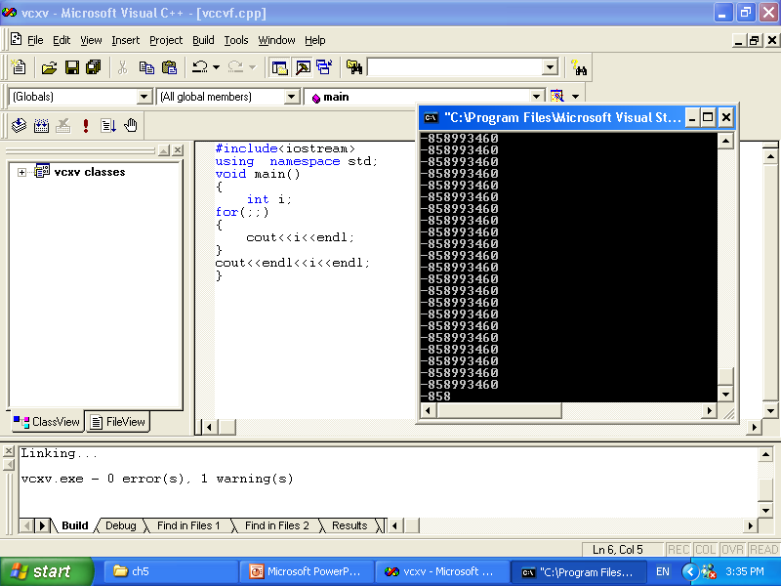
Infinite loop

Slide 234
What is the out put
#include<iostream>
using namespace std;
void main()
{
int i;
for(i=1;i<10;++i);
{
cout<<i<<endl;
}
cout<<endl<<i<<endl;
}

Slide 235
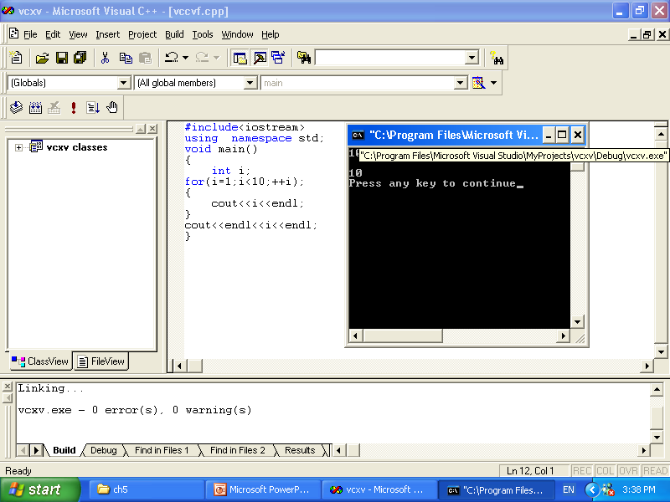
The output

Slide 236
x to the y power
// raise x to the y power
#include <iostream>
using namespace std;
int main()
{
int x, y, i, power;
i = 1;
power = 1;
cout << "Enter base as an integer: ";
cin >> x;
cout << "Enter exponent as an integer: ";
cin >> y;
while ( i <= y ) {
power *= x;
++i;
}
cout << power << endl;
return 0;
}

Slide 237
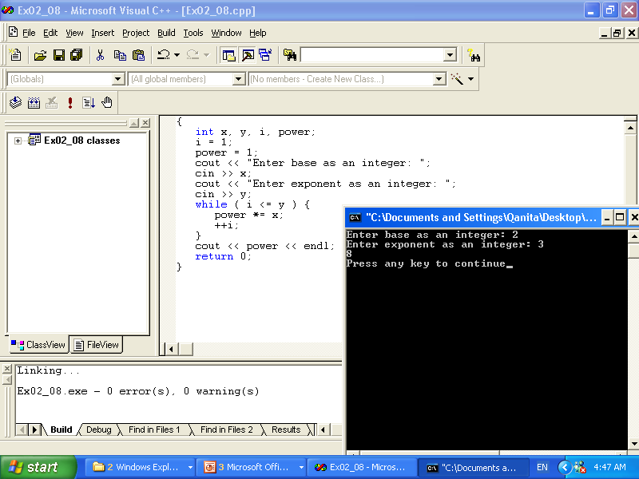

Slide 238
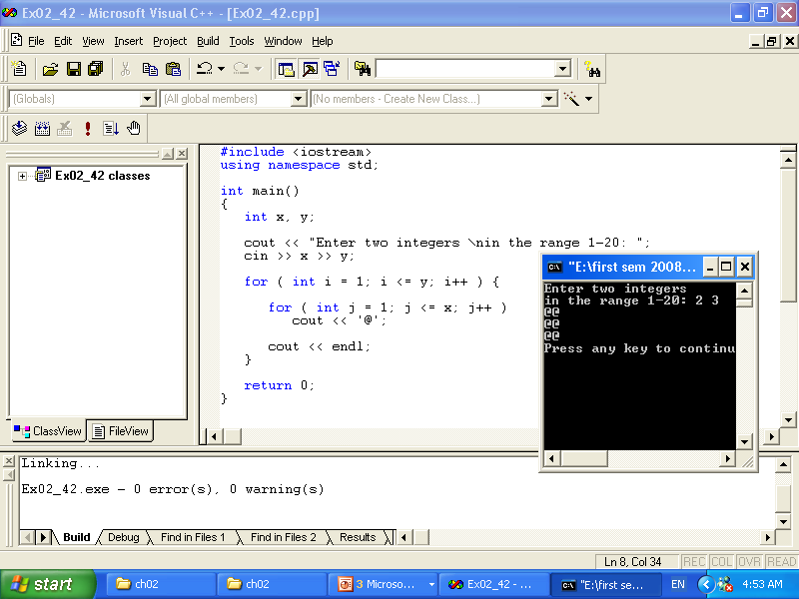

Slide 239
// Class average program with counter-controlled repetition (Example)
#include <iostream>
using namespace std;
int main()
{
int total, // sum of grades
gradeCounter, // number of grades entered
grade, // one grade
average; // average of grades
// initialization phase
total = 0; // clear total
gradeCounter = 1; // prepare to loop
// processing phase
while ( gradeCounter <= 5 ) { // loop 10 times
cout << "Enter grade: "; // prompt for input
cin >> grade; // input grade
total = total + grade; // add grade to total
gradeCounter = gradeCounter + 1; // increment counter
}
// termination phase
average = total / 5; // integer division
cout << "Class average is " << average << endl;
return 0; // indicate program ended successfully
}

Slide 240
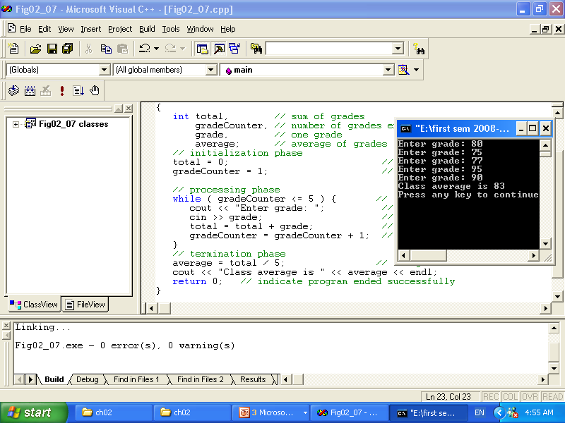

Slide 241
Example
// Counter-controlled repetition
#include <iostream>
using namespace std;
int main()
{
int counter = 1; // initialization
while ( counter <= 10 ) { // repetition condition
cout << counter << endl;
++counter; // increment
}
return 0;
}

Slide 242
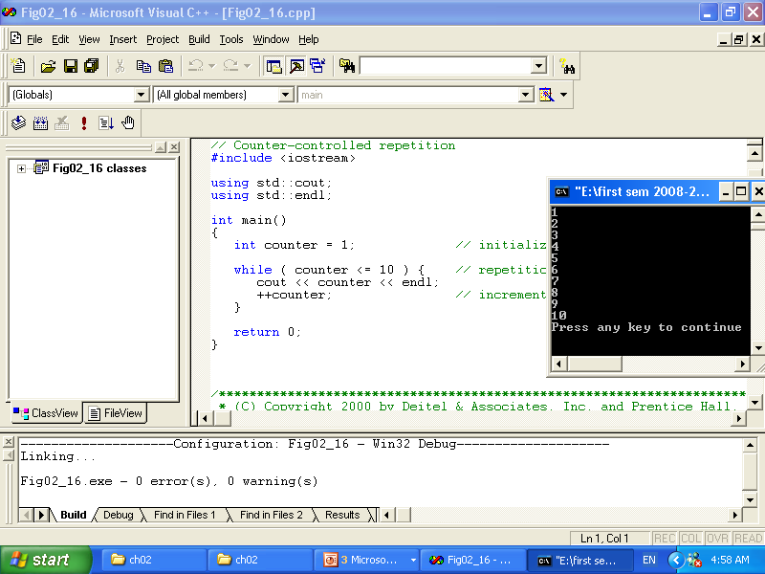

Slide 243
// Summation with for example
#include <iostream>
using namespace std;
int main()
{
int sum = 0;
for ( int number = 1; number <= 10; number += 2 )
{ cout<<number<<endl;
sum += number;
}
cout <<endl<< "Sum is " << sum << endl<<endl;
return 0;
}

Slide 244

Summation with for example

Slide 245
Using the break statement in a for structure
// Using the break statement in a for structure
#include <iostream>
using namespace std;
int main()
{
// x declared here so it can be used after the loop
int x;
for ( x = 1; x <= 10; x++ ) {
if ( x == 5 )
break; // break loop only if x is 5
cout << x << " ";
}
cout << "\nBroke out of loop at x of " << x << endl;
return 0;
}

Slide 246


Slide 247
// Using the continue statement in a for structure
// Using the continue statement in a for structure
#include <iostream>
using namespace std;
int main()
{
for ( int x = 1; x <= 10; x++ ) {
if ( x == 5 )
continue; // skip remaining code in loop
// only if x is 5
cout << x << " ";
}
cout << "\nUsed continue to skip printing the value 5"
<< endl;
return 0;
}

Slide 248

// Using the continue statement in a for structure

Slide 249
example
#include <iostream>
using namespace std;
int main()
{
int count = 1;
while ( count <= 10 ) {
cout << (count % 2 ? "****" : "++++++++")
<< endl;
++count;
}
return 0;
}

Slide 250


Slide 251
Nested Control Structures
#include <iostream>
using namespace std;
int main ()
{
int i,j;
for (i = 1; i <= 5 ; i++)
{
for (j = 1; j <= i; j++)
cout << "*";
cout << endl;
}
return 0;
}

Slide 252

Nested Control Structures

Slide 253
Nested Control Structures
#include <iostream>
using namespace std;
int main ()
{
int i,j;
for (i = 1; i <= 5 ; i++)
{
for (j = i; j <= 5; j++)
cout << "*";
cout << endl;
}
return 0;
}

Slide 254

Nested Control Structures

Slide 255
Nested Control Structures
#include <iostream>
using namespace std;
int main ()
{
int i,j;
for (i = 1; i <= 5 ; i++)
{
for (j = 1; j <= 5; j++)
cout << "*";
cout << endl;
}
return 0;
}

Slide 256

Nested Control Structures

Slide 257
Count Control
#include<iostream>
using namespace std;
int main()
{
int limit; //variable to store the number of items
//in the list
int number; //variable to store the number
int sum; //variable to store the sum
int counter; //loop control variable
cout << "Line 1: Enter number of data for processing"
<< endl; //Line 1
cin >> limit; //Line 2
sum = 0; //Line 3
counter = 0; //Line 4
while (counter < limit) //Line 5
{
cout<<"the number is:";
cin >> number; //Line 6
sum = sum + number; //Line 7
counter++; //Line 8
}
cout << "Line 9: The sum of the " << limit
<< " numbers = " << sum << endl; //Line 9
if (counter != 0) //Line 10
cout << "Line 11: The average = "
<< sum / counter << endl; //Line 11
else //Line 12
cout << "Line 13: No input." << endl; //Line 13
return 0;
}

Slide 258
//Flag-controlled while loop.
//Number guessing game.
#include <iostream>
#include <cstdlib>
#include <ctime>
using namespace std;
int main()
{
//declare the variables
int num; //variable to store the random
//number
int guess; //variable to store the number
//guessed by the user
bool done; //boolean variable to control
//the loop
num = (rand() + time(0)) % 100; //Line 1
done = false; //Line 2
while (!done) //Line 3
{ //Line 4
cout << "Enter an integer greater" << " than or equal to 0 and "<< "less than 100: "; //Line 5
cin >> guess; //Line 6
cout << endl; //Line 7
if (guess == num) //Line 8
{ //Line 9
cout << "You guessed the correct "
<< "number." << endl; //Line 10
done = true; //Line 11
} //Line 12
else //Line 13
if (guess < num) //Line 14
cout << "Your guess is lower "
<< "than the number.\n"
<< "Guess again!" << endl; //Line 15
else //Line 16
cout << "Your guess is higher "
<< "than the number.\n"
<< "Guess again!" << endl; //Line 17
} //end while //Line 18
return 0;
}

Slide 259
Sentinel Control
//Program: AVG2
#include <iostream>
using namespace std;
const int SENTINEL = -999;
int main()
{
int number; //variable to store the number
int sum = 0; //variable to store the sum
int count = 0; //variable to store the total
//numbers read
cout << "Line 1: Enter integers ending with "
<< SENTINEL << endl; //Line 1
cin >> number; //Line 2
while (number != SENTINEL) //Line 3
{
sum = sum + number; //Line 4
count++; //Line 5
cin >> number; //Line 6
}
cout << "Line 7: The sum of the " << count
<< " numbers is " << sum << endl; //Line 7
if (count != 0) //Line 8
cout << "Line 9: The average is "
<< sum / count << endl; //Line 9
else //Line 10
cout << "Line 11: No input." << endl; //Line 11
return 0;
}

Slide 260
The do…while Loop
#include <iostream>
using namespace std;
int main()
{
int i=1;
do
{
cout<<i<<endl;
i++;
}
while(i<=10);
cout<<endl<<i<<endl;
return 0;
}

Slide 261


Slide 262
#include <iostream>
using namespace std;
int main()
{
int i=1;
do
cout<<i;
{
cout<<endl;
i++;
}
while(i<=10);
cout<<endl<<i<<endl;
return 0;
}

Slide 263


Slide 264
#include <iostream>
using namespace std;
int main()
{
int i=1;
do
{
cout<<i<<endl;
i++;
}
while(i<=10)
cout<<endl<<i;
return 0;
}

Slide 265


Slide 266
User-Defined Functions-I

Slide 267
Objectives
In this chapter, you will:
Learn about standard (predefined) functions and discover how to use them in a program
Learn about user-defined functions
Examine value-returning functions, including actual and formal parameters
Explore how to construct and use a value-returning, user-defined function in a program

Slide 268
Introduction
Functions are like building blocks
They allow complicated programs to be divided into manageable pieces
Some advantages of functions:
A programmer can focus on just that part of the program and construct it, debug it, and perfect it
Different people can work on different functions simultaneously
Can be re-used (even in different programs)
Enhance program readability

Slide 269
Introduction (continued)
Functions
Called modules
Like miniature programs
Can be put together to form a larger program

Slide 270

Why functions?

Slide 271

Why functions?

Slide 272

Why functions?

Slide 273

Why functions?

Slide 274
Predefined Functions
In algebra, a function is defined as a rule or correspondence between values, called the function’s arguments, and the unique value of the function associated with the arguments
If f(x) = 2x + 5, then f(1) = 7, f(2) = 9, and f(3) = 11
1, 2, and 3 are arguments
7, 9, and 11 are the corresponding values

Slide 275
Predefined Functions (continued)
Some of the predefined mathematical functions are:
sqrt(x)
pow(x, y)
floor(x)
Predefined functions are organized into separate libraries
I/O functions are in iostream header
Math functions are in cmath header

Slide 276
Predefined Functions (continued)
pow(x,y) calculates x^{y}
pow(2, 3) = 8.0
Returns a value of type double
x and y are the parameters (or arguments)
The function has two parameters
sqrt(x) calculates the nonnegative square root of x, for x >= 0.0
sqrt(2.25) is 1.5
Type double

Slide 277
Predefined Functions (continued)
The floor function floor(x) calculates largest whole number not greater than x
floor(48.79) is 48.0
Type double
Has only one parameter

Slide 278
Predefined Functions (continued)

Slide 279
Predefined Functions (continued)

Slide 281
Predefined Functions (continued)
Example 6-1 sample run:

Slide 282
User-Defined Functions
Value-returning functions: have a return type
Return a value of a specific data type using the return statement
Void functions: do not have a return type
Do not use a return statement to return a value

Slide 283
Value-Returning Functions
To use these functions you must:
Include the appropriate header file in your program using the include statement
Know the following items:
Name of the function
Number of parameters, if any
Data type of each parameter
Data type of the value returned: called the type of the function

Slide 284
Value-Returning Functions (continued)
Because the value returned by a value-returning function is unique, we must:
Save the value for further calculation
Use the value in some calculation
Print the value
A value-returning function is used in an assignment or in an output statement
One more thing is associated with functions:
The code required to accomplish the task

Slide 285

Value-Returning Functions (continued)

Slide 286
Value-Returning Functions (continued)
Heading: first four properties above
Example: int abs(int number)
Formal Parameter: variable declared in the heading
Example: number
Actual Parameter: variable or expression listed in a call to a function
Example: x = pow(u, v)

Slide 287

Syntax: Value-Returning Function
Syntax:
functionType is also called the data type or return type

Slide 288
Syntax: Formal Parameter List

Slide 289
Function Call

Slide 290
Syntax: Actual Parameter List
The syntax of the actual parameter list is:
Formal parameter list can be empty:
A call to a value-returning function with an empty formal parameter list is:

Slide 291
return Statement
Once a value-returning function computes the value, the function returns this value via the return statement
It passes this value outside the function via the return statement

Slide 292
Syntax: return Statement
The return statement has the following syntax:
In C++, return is a reserved word
When a return statement executes
Function immediately terminates
Control goes back to the caller
When a return statement executes in the function main, the program terminates

Slide 294
Function Prototype
Function prototype: function heading without the body of the function
Syntax:
It is not necessary to specify the variable name in the parameter list
The data type of each parameter must be specified

Slide 295



Slide 296
Function Prototype (continued)

Slide 297
Palindrome Number
A nonnegative integer is a palindrome if it reads forward and backward in the same way
Examples: 5, 44, 789656987

Slide 298
Palindrome Number (continued)

Slide 299
Flow of Execution
Execution always begins at the first statement in the function main
Other functions are executed only when they are called
Function prototypes appear before any function definition
The compiler translates these first
The compiler can then correctly translate a function call

Slide 300
Flow of Execution (continued)
A function call results in transfer of control to the first statement in the body of the called function
After the last statement of a function is executed, control is passed back to the point immediately following the function call
A value-returning function returns a value
After executing the function the returned value replaces the function call statement

Slide 301
Programming Example: Largest Number
The function larger is used to determine the largest number from a set of numbers
Program determines the largest number from a set of 10 numbers
Input: a set of 10 numbers
Output: the largest of 10 numbers

Slide 302
Programming Example: Program Analysis
Suppose that the input data is:
15 20 7 8 28 21 43 12 35 3
Read the first number of the data set
Because this is the only number read to this point, you may assume that it is the largest number so far and call it max
Read the second number and call it num
Compare max and num, and store the larger number into max

Slide 303
Programming Example: Program Analysis (continued)
Now max contains the larger of the first two numbers
Read the third number and compare it with max and store the larger number into max
max contains the largest of the first three numbers
Read the next number, compare it with max, and store the larger into max
Repeat this process for each remaining number in the data set

Slide 304
Programming Example: Algorithm Design
Read the first number
Because this is the only number that you have read, it is the largest number so far
Save it in a variable called max
For each remaining number in the list
Read the next number
Store it in a variable called num
Compare num and max

Slide 305
Programming Example: Algorithm Design (continued)
For each remaining number in the list (continued)
If max < num
num is the new largest number
update the value of max by copying num into max
If max >= num, discard num; that is, do nothing
Because max now contains the largest number, print it

Slide 306
Summary
Functions (modules) are miniature programs
Divide a program into manageable tasks
C++ provides the standard functions
Two types of user-defined functions: value-returning functions and void functions
Variables defined in a function heading are called formal parameters
Expressions, variables, or constant values in a function call are called actual parameters

Slide 307
Summary (continued)
In a function call, the number of actual parameters and their types must match with the formal parameters in the order given
To call a function, use its name together with the actual parameter list
Function heading and the body of the function are called the definition of the function
If a function has no parameters, you need empty parentheses in heading and call
A value-returning function returns its value via the return statement

Slide 308
Summary (continued)
A prototype is the function heading without the body of the function; prototypes end with the semicolon
Prototypes are placed before every function definition, including main
User-defined functions execute only when they are called
In a call statement, specify only the actual parameters, not their data types

Slide 309
User-Defined Functions II

Slide 310
Objectives
In this chapter, you will:
Learn how to construct and use void functions in a program
Discover the difference between value and reference parameters
Explore reference parameters and value-returning functions
Learn about the scope of an identifier

Slide 311
Objectives (continued)
Examine the difference between local and global identifiers
Discover static variables
Learn function overloading
Explore functions with default parameters

Slide 312
Void Functions
Void functions and value-returning functions have similar structures
Both have a heading part and a statement part
User-defined void functions can be placed either before or after the function main
If user-defined void functions are placed after the function main
The function prototype must be placed before the function main

Slide 313
Void Functions (continued)
A void function does not have a return type
return statement without any value is typically used to exit the function early
Formal parameters are optional
A call to a void function is a stand-alone statement

Slide 314


Void Functions without Parameters
Function definition syntax:
void is a reserved word
Function call syntax:

Slide 315

Void Functions with Parameters
Function definition syntax:
Formal parameter list syntax:
Function call syntax:
Actual parameter list syntax:

Slide 316


Void Functions with Parameters (continued)

Slide 317
Void Functions with Parameters (continued)
Value parameter: a formal parameter that receives a copy of the content of corresponding actual parameter
Reference parameter: a formal parameter that receives the location (memory address) of the corresponding actual parameter

Slide 318
Value Parameters
If a formal parameter is a value parameter
The value of the corresponding actual parameter is copied into it
The value parameter has its own copy of the data
During program execution
The value parameter manipulates the data stored in its own memory space

Slide 319
Reference Variables as Parameters
If a formal parameter is a reference parameter
It receives the memory address of the corresponding actual parameter
A reference parameter stores the address of the corresponding actual parameter
During program execution to manipulate data
The address stored in the reference parameter directs it to the memory space of the corresponding actual parameter

Slide 320
Reference Variables as Parameters (continued)
Reference parameters can:
Pass one or more values from a function
Change the value of the actual parameter
Reference parameters are useful in three situations:
Returning more than one value
Changing the actual parameter
When passing the address would save memory space and time

Slide 321
Calculate Grade

Slide 322
Calculate Grade (continued)

Slide 323


Slide 324
Value and Reference Parameters and Memory Allocation
When a function is called
Memory for its formal parameters and variables declared in the body of the function (called local variables) is allocated in the function data area
In the case of a value parameter
The value of the actual parameter is copied into the memory cell of its corresponding formal parameter

Slide 325
Value and Reference Parameters and Memory Allocation (continued)
In the case of a reference parameter
The address of the actual parameter passes to the formal parameter
Content of formal parameter is an address
During execution, changes made by the formal parameter permanently change the value of the actual parameter
Stream variables (e.g., ifstream) should be passed by reference to a function

Slide 326


Slide 327


Slide 328


Slide 329




Slide 330


Slide 332


Slide 333
Reference Parameters and Value-Returning Functions
You can also use reference parameters in a value-returning function
Not recommended
By definition, a value-returning function returns a single value
This value is returned via the return statement
If a function needs to return more than one value, you should change it to a void function and use the appropriate reference parameters to return the values

Slide 334
Scope of an Identifier
The scope of an identifier refers to where in the program an identifier is accessible
Local identifier: identifiers declared within a function (or block)
Global identifier: identifiers declared outside of every function definition
C++ does not allow nested functions
The definition of one function cannot be included in the body of another function

Slide 335


Slide 336
Scope of an Identifier (continued)
Some compilers initialize global variables to default values
The operator :: is called the scope resolution operator
By using the scope resolution operator
A global variable declared before the definition of a function (block) can be accessed by the function (or block) even if the function (or block) has an identifier with the same name as the variable

Slide 337
Scope of an Identifier (continued)
C++ provides a way to access a global variable declared after the definition of a function
In this case, the function must not contain any identifier with the same name as the global variable

Slide 338
Global Variables, Named Constants, and Side Effects
Using global variables has side effects
A function that uses global variables is not independent
If more than one function uses the same global variable and something goes wrong
It is difficult to find what went wrong and where
Problems caused in one area of the program may appear to be from another area
Global named constants have no side effects

Slide 339
Static and Automatic Variables
Automatic variable: memory is allocated at block entry and deallocated at block exit
By default, variables declared within a block are automatic variables
Static variable: memory remains allocated as long as the program executes
Variables declared outside of any block are static variables
Declare a static variable within a block by using the reserved word static

Slide 340

Static and Automatic Variables (continued)
The syntax for declaring a static variable is:
The statement
static int x;
declares x to be a static variable of the type int
Static variables declared within a block are local to the block
Their scope is the same as any other local identifier of that block

Slide 341
Function Overloading: An Introduction
In a C++ program, several functions can have the same name
This is called function overloading or overloading a function name

Slide 342
Function Overloading (continued)
Two functions are said to have different formal parameter lists if both functions have:
A different number of formal parameters, or
If the number of formal parameters is the same, then the data type of the formal parameters, in the order you list them, must differ in at least one position

Slide 343
Function Overloading (continued)
The following functions all have different formal parameter lists:
The following functions have the same formal parameter list:

Slide 344
Function Overloading (continued)
Function overloading: creating several functions with the same name
The signature of a function consists of the function name and its formal parameter list
Two functions have different signatures if they have either different names or different formal parameter lists
Note that the signature of a function does not include the return type of the function

Slide 345
Function Overloading (continued)
Correct function overloading:
Syntax error:

Slide 346
Functions with Default Parameters
In a function call, the number of actual and formal parameters must be the same
C++ relaxes this condition for functions with default parameters
You specify the value of a default parameter when the function name appears for the first time (e.g., in the prototype)
If you do not specify the value of a default parameter, the default value is used

Slide 347
Functions with Default Parameters (continued)
All default parameters must be the rightmost parameters of the function
In a function call where the function has more than one default parameter and a value to a default parameter is not specified:
You must omit all of the arguments to its right
Default values can be constants, global variables, or function calls
However, you cannot assign a constant value as a default value to a reference parameter

Slide 348
Functions with Default Parameters (continued)
Consider the following prototype:
Assume:
a, b are int, ch is char, d is double
Examples of legal calls:
Examples of illegal calls:

Slide 349
Functions with Default Parameters (continued)
Examples of illegal function prototypes with default parameters:

Slide 350
Programming Example: Classify Numbers
In this example, we use functions to rewrite the program that determines the number of odds and evens from a given list of integers
Main algorithm remains the same:
Initialize variables, zeros, odds, evens to 0
Read a number
If number is even, increment the even count
If number is also zero, increment the zero count; else increment the odd count
Repeat Steps 2-3 for each number in the list

Slide 351
Programming Example: Classify Numbers (continued)
The program functions include:
initialize: initialize the variables, such as zeros, odds, and evens
getNumber: get the number
classifyNumber: determine if number is odd or even (and whether it is also zero); this function also increments the appropriate count
printResults: print the results

Slide 352


Slide 353
Programming Example: Main Algorithm
Call initialize to initialize variables
Prompt the user to enter 20 numbers
For each number in the list
Call getNumber to read a number
Output the number
Call classifyNumber to classify the number and increment the appropriate count
Call printResults to print the final results

Slide 355
Summary
Void function: does not have a data type
A return statement without any value can be used in a void function to exit it early
The heading starts with the word void
To call the function, you use the function name together with the actual parameters in a stand-alone statement
Two types of formal parameters:
Value parameters
Reference parameters

Slide 356
Summary (continued)
A value parameter receives a copy of its corresponding actual parameter
A reference parameter receives the memory address of its corresponding actual parameter
If a formal parameter needs to change the value of an actual parameter, you must declare this formal parameter as a reference parameter in the function heading

Slide 357
Summary (continued)
Variables declared within a function (or block) are called local variables
Variables declared outside of every function definition (and block) are global variables
Automatic variable: variable for which memory is allocated on function/block entry and deallocated on function/block exit
Static variable: memory remains allocated throughout the execution of the program
C++ functions can have default parameters

Slide 358
Chapter 8: User-Defined Simple Data Types, Namespaces, and the string Type

Slide 359
Objectives
In this chapter, you will:
Learn how to create and manipulate your own simple data type—called the enumeration type
Become familiar with the typedef statement
Learn about the namespace mechanism
Explore the string data type, and learn how to use the various string functions to manipulate strings

Slide 360
Enumeration Type
Data type: a set of values together with a set of operations on those values
To define a new simple data type, called enumeration type, we need three things:
A name for the data type
A set of values for the data type
A set of operations on the values

Slide 361
Enumeration Type (continued)
A new simple data type can be defined by specifying its name and the values, but not the operations
The values must be identifiers
Syntax:
value1, value2, … are identifiers called enumerators
value1 < value2 < value3 <...

Slide 362
Enumeration Type (continued)
Enumeration type is an ordered set of values
If a value has been used in one enumeration type it can’t be used by another in same block
The same rules apply to enumeration types declared outside of any blocks

Slide 363

Enumeration Type (continued)

Slide 364


Slide 365

Declaring Variables
Syntax:
For example, given the following definition:
we can declare the following variables:

Slide 366
Assignment
The statement:
popularSport = FOOTBALL;
stores FOOTBALL into popularSport
The statement:
mySport = popularSport;
copies the value of the popularSport into mySport

Slide 367
Operations on Enumeration Types
No arithmetic operations are allowed on enumeration types
++ and -- are illegal too:
Solution: use a static cast:

Slide 368
Relational Operators
An enumeration type is an ordered set of values:
Enumeration type is an integer data type and can be used in loops:

Slide 369
Input /Output of Enumeration Types
I/O are defined only for built-in data types
Enumeration type cannot be input/output (directly)

Slide 370
Functions and Enumeration Types
Enumeration types can be passed as parameters to functions either by value or by reference
A function can return a value of the enumeration type

Slide 371
Declaring Variables When Defining the Enumeration Type
You can declare variables of an enumeration type when you define an enumeration type:

Slide 372
Anonymous Data Types
Anonymous type : values are directly specified in the declaration, with no type name
Drawbacks:
Cannot pass/return an anonymous type to/from a function
Values used in one type can be used in another, but are treated differently:

Slide 373
typedef Statement
You can create synonyms or aliases to a data type using the typedef statement
Syntax:
typedef does not create any new data types
Creates an alias to an existing data type

Slide 374
Namespaces
ANSI/ISO standard C++ was officially approved in July 1998
Most of the recent compilers are also compatible with ANSI/ISO standard C++
For the most part, standard C++ and ANSI/ISO standard C++ are the same
However, ANSI/ISO Standard C++ has some features not available in Standard C++

Slide 375
Namespaces (continued)
Global identifiers in a header file used in a program become global in the program
Syntax error occurs if an identifier in a program has the same name as a global identifier in the header file
Same problem can occur with third-party libraries
Common solution: third-party vendors begin their global identifiers with _ (underscore)
Do not begin identifiers in your program with _

Slide 376
Namespaces (continued)
ANSI/ISO Standard C++ attempts to solve this problem with the namespace mechanism
Syntax:
where a member is usually a variable declaration, a named constant, a function, or another namespace

Slide 377
Namespaces (continued)

Slide 378
Namespaces (continued)
The scope of a namespace member is local to the namespace
Ways a namespace member can be accessed outside the namespace:

Slide 379
Accessing a namespace Member
Examples:
globalType::RATE
globalType::printResult();
After the using statement, it is not necessary to precede the namespace_name:: before the namespace member
Unless a namespace member and a global identifier or a block identifier have same name

Slide 380
string Type
To use the data type string, the program must include the header file string
The statement:
string name = "William Jacob";
declares name to be a string variable and also initializes name to "William Jacob"
The first character, 'W', is in position 0
The second character, 'i', is in position 1
name is capable of storing any size string

Slide 381
string Type (continued)
Binary operator + and the array subscript operator [], have been defined for the data type string
+ performs the string concatenation operation
Example:
str1 = "Sunny";
str2 = str1 + " Day";
stores "Sunny Day" into str2

Slide 382
Additional string Operations
length
size
find
substr
swap

Slide 383
length Function
Returns the number of characters currently in the string
Syntax:
where strVar is variable of the type string
length returns an unsigned integer
The value returned can be stored in an integer variable

Slide 385

size Function
size is the same as the function length
Both functions return the same value
Syntax:
where strVar is variable of the type string
As in the case of the function length, the function size has no arguments

Slide 386
find Function
Searches a string for the first occurrence of a particular substring
Returns an unsigned integer value of type string::size_type
Or string::npos if unsuccessful
Syntax:
strExp can be a string or a character

Slide 387

find Function (continued)

Slide 388
substr Function
Returns a particular substring of a string
Syntax:
expr1 and expr2 are expressions evaluating to unsigned integers
expr1 specifies a position within the string (starting position of the substring)
expr2 specifies the length of the substring to be returned

Slide 389

substr Function (continued)

Slide 390
swap Function
Interchanges contents of two string variables
Syntax:
where strVar1 and strVar2 are string variables
Suppose you have the following statements:
string str1 = "Warm";
string str2 = "Cold";
After str1.swap(str2); executes, the value of str1 is "Cold" and the value of str2 is "War"

Slide 391
Programming Example: Pig Latin Strings
Program prompts user to input a string
Then outputs the string in the pig Latin form
The rules for converting a string into pig Latin form are as follows:
If the string begins with a vowel, add the string "-way" at the end of the string
Example: the pig Latin form of "eye" is "eye-way"

Slide 392
Programming Example: Pig Latin Strings (continued)
Rules (continued):
If the string does not begin with a vowel, first add "-" at the end of the string
Then move the first character of the string to the end of the string until the first character of the string becomes a vowel
Next, add the string "ay" at the end
Example: pig Latin form of "There" is "ere-Thay"

Slide 393
Programming Example: Pig Latin Strings (continued)
Rules (continued):
Strings such as "by" contain no vowels
The letter 'y' can be considered a vowel
For this program the vowels are a, e, i, o, u, y, A, E, I, O, U, and Y
Strings such as "1234" contain no vowels
The pig Latin form of a string that has no vowels in it is the string followed by the string "-way"
Example: pig Latin form of "1234" is "1234-way"

Slide 394
Programming Example: Problem Analysis
If str denotes a string:
Check the first character, str[0], of str
If it is a vowel, add "-way" at the end of str
If it is not a vowel:
First add "-" at the end of the string
Remove the first character of str from str and put it at end of str
Now the second character of str becomes the first character of str

Slide 395
Programming Example: Problem Analysis (continued)
If str denotes a string (continued):
This process is repeated until either
The first character of str is a vowel
All characters of str are processed, in which case str does not contain any vowels

Slide 396
Programming Example: Algorithm Design
The program contains the following functions:
isVowel determines if a character is a vowel
rotate moves first character of str to the end of str
pigLatinString finds pig Latin form of str
Steps in the algorithm:
Get str
Use pigLatinString to find the pig Latin form of str
Output the pig Latin form of str

Slide 397
Programming Example: Function isVowel

Slide 398
Programming Example: Function rotate
Takes a string as a parameter
Removes the first character of the string
Places it at end of the string by extracting the substring starting at position 1 until the end of the string, then adding the first character of the string

Slide 399
Programming Example: Function pigLatinString
If pStr[0] is a vowel, add "-way" at end
If pStr[0] is not a vowel:
Move first character of pStr to the end of pStr
The second character of pStr becomes the first character of pStr
Now pStr may or may not contain a vowel
Use a bool variable, foundVowel, which is set to true if pStr contains a vowel and false otherwise
Initialize foundVowel to false

Slide 400
Programming Example: Function pigLatinString (continued)
If pStr[0] is not a vowel, move str[0] to the end of pStr by calling the function rotate
Repeat third step until either the first character of pStr becomes a vowel or all characters of pStr have been checked
Convert pStr into the pig Latin form
Return pStr

Slide 401
Programming Example: Main Algorithm
Get the string
Call pigLatinString to find the pig Latin form of the string
Output the pig Latin form of the string

Slide 402
Summary
Enumeration type: set of ordered values
Created with reserved word enum creates an enumeration type
No arithmetic operations are allowed on the enumeration type
Relational operators can be used with enum values
Enumeration type values cannot be input or output directly

Slide 403
Summary (continued)
Anonymous type: a variable’s values are specified without any type name
Reserved word typedef creates synonyms or aliases to previously defined data types
The namespace mechanism is a feature of ANSI/ISO Standard C++
A namespace member is usually a named constant, variable, function, or another namespace

Slide 404
Summary (continued)
Keyword namespace must appear in the using statement
A string is a sequence of zero or more characters
Strings in C++ are enclosed in ""
In C++, [] is the array subscript operator
The function length returns the number of characters currently in the string

Slide 405
Summary (continued)
The function size returns the number of characters currently in the string
The function find searches a string to locate the first occurrence of a particular substring
The function substr returns a particular substring of a string
The function swap is used to swap the contents of two string variables

Slide 406
Arrays and Strings

Slide 407
Objectives
In this chapter, you will:
Learn about arrays
Explore how to declare and manipulate data into arrays
Understand the meaning of “array index out of bounds”
Become familiar with the restrictions on array processing
Discover how to pass an array as a parameter to a function

Slide 408
Objectives (continued)
Learn about C-strings
Examine the use of string functions to process C-strings
Discover how to input data into—and output data from—a C-string
Learn about parallel arrays
Discover how to manipulate data in a two-dimensional array
Learn about multidimensional arrays

Slide 409
Data Types
A data type is called simple if variables of that type can store only one value at a time
A structured data type is one in which each data item is a collection of other data items

Slide 410
Arrays
Array: a collection of a fixed number of components wherein all of the components have the same data type
In a one-dimensional array, the components are arranged in a list form
Syntax for declaring a one-dimensional array:
intExp evaluates to a positive integer

Slide 411

Arrays (continued)
Example:
int num[5];

Slide 412
Accessing Array Components
General syntax:
where indexExp, called an index, is any expression whose value is a nonnegative integer
Index value specifies the position of the component in the array
[] is the array subscripting operator
The array index always starts at 0

Slide 413
Accessing Array Components (continued)

Slide 414

Accessing Array Components (continued)

Slide 415

Accessing Array Components (continued)

Slide 416

Accessing Array Components (continued)

Slide 417
Processing One-Dimensional Arrays
Some basic operations performed on a one-dimensional array are:
Initializing
Inputting data
Outputting data stored in an array
Finding the largest and/or smallest element
Each operation requires ability to step through the elements of the array
Easily accomplished by a loop

Slide 418
Processing One-Dimensional Arrays (continued)
Consider the declaration
int list[100]; //array of size 100
int i;
Using for loops to access array elements:
for (i = 0; i < 100; i++) //Line 1
//process list[i] //Line 2
Example:
for (i = 0; i < 100; i++) //Line 1
cin >> list[i]; //Line 2

Slide 419


Slide 420
Array Index Out of Bounds
If we have the statements:
double num[10];
int i;
The component num[i] is valid if i = 0, 1, 2, 3, 4, 5, 6, 7, 8, or 9
The index of an array is in bounds if the index >=0 and the index <= ARRAY_SIZE-1
Otherwise, we say the index is out of bounds
In C++, there is no guard against indices that are out of bounds

Slide 421
Array Initialization During Declaration
Arrays can be initialized during declaration
In this case, it is not necessary to specify the size of the array
Size determined by the number of initial values in the braces
Example:
double sales[] = {12.25, 32.50, 16.90, 23, 45.68};

Slide 422
Partial Initialization of Arrays During Declaration
The statement:
int list[10] = {0};
declares list to be an array of 10 components and initializes fist element to be zero then the rest of elements are zero
The statement:
int list[10] = {8, 5, 12};
declares list to be an array of 10 components, initializes list[0] to 8, list[1] to 5, list[2] to 12 and all other components are initialized to 0

Slide 423
Partial Initialization of Arrays During Declaration (continued)
The statement:
int list[] = {5, 6, 3};
declares list to be an array of 3 components and initializes list[0] to 5, list[1] to 6, and list[2] to 3
The statement:
int list[25]= {4, 7};
declares an array of 25 components; initializes list[0] to 4 and list[1] to 7; all other components are initialized to 0

Slide 424
Some Restrictions on Array Processing
Consider the following statements:
C++ does not allow aggregate operations on an array:
Solution:

Slide 425



Some Restrictions on Array Processing (continued)
The following is illegal too:
Solution:
The following statements are legal, but do not give the desired results:

Slide 426
Arrays as Parameters to Functions
Arrays are passed by reference only
The symbol & is not used when declaring an array as a formal parameter
The size of the array is usually omitted
If provided, it is ignored by the compiler

Slide 427
Constant Arrays as Formal Parameters

Slide 428
Base Address of an Array and Array in Computer Memory
The base address of an array is the address, or memory location of the first array component
If list is a one-dimensional array, its base address is the address of list[0]
When we pass an array as a parameter, the base address of the actual array is passed to the formal parameter

Slide 430
Functions Cannot Return a Value of the Type Array
C++ does not allow functions to return a value of the type array

Slide 431
Integral Data Type and Array Indices
C++ allows any integral type to be used as an array index
Example:

Slide 432

Other Ways to Declare Arrays

Slide 433
C-Strings (Character Arrays)
Character array: an array whose components are of type char
C-strings are null-terminated ('\0') character arrays
Example:
'A' is the character A
"A" is the C-string A
"A" represents two characters, 'A' and '\0‘

Slide 434
C-Strings (Character Arrays) (continued)
Consider the statement
char name[16];
Since C-strings are null terminated and name has 16 components, the largest string that it can store has 15 characters
If you store a string of length, say 10 in name
The first 11 components of name are used and the last five are left unused

Slide 435
C-Strings (Character Arrays) (continued)
The statement
char name[16] = "John";
declares an array name of length 16 and stores the C-string "John" in it
The statement
char name[] = "John";
declares an array name of length 5 and stores the C-string "John" in it

Slide 436
C-Strings (Character Arrays) (continued)

Slide 437
String Comparison
C-strings are compared character by character using the collating sequence of the system
If we are using the ASCII character set
"Air" < "Boat"
"Air" < "An"
"Bill" < "Billy"
"Hello" < "hello"

Slide 439
Reading and Writing Strings
Most rules that apply to arrays apply to C-strings as well
Aggregate operations, such as assignment and comparison, are not allowed on arrays
Even the input/output of arrays is done component-wise
The one place where C++ allows aggregate operations on arrays is the input and output of C-strings (that is, character arrays)

Slide 440
String Input
cin >> name; stores the next input C-string into name
To read strings with blanks, use get:
cin.get(str, m+1);
Stores the next m characters into str but the newline character is not stored in str
If the input string has fewer than m characters, the reading stops at the newline character

Slide 441
String Output
cout << name; outputs the content of name on the screen
<< continues to write the contents of name until it finds the null character
If name does not contain the null character, then we will see strange output
<< continues to output data from memory adjacent to name until '\0' is found

Slide 442

Specifying Input/Output Files at Execution Time
You can let the user specify the name of the input and/or output file at execution time:

Slide 443
string Type and Input/Output Files
Argument to the function open must be a null-terminated string (a C-string)
If we use a variable of type string to read the name of an I/O file, the value must first be converted to a C-string before calling open
Syntax:
strVar.c_str()
where strVar is a variable of type string

Slide 444
Parallel Arrays
Two (or more) arrays are called parallel if their corresponding components hold related information
Example:
int studentId[50];
char courseGrade[50];

Slide 445

Two-Dimensional Arrays
Two-dimensional array: collection of a fixed number of components (of the same type) arranged in two dimensions
Sometimes called matrices or tables
Declaration syntax:
where intexp1 and intexp2 are expressions yielding positive integer values, and specify the number of rows and the number of columns, respectively, in the array

Slide 446

Two-Dimensional Arrays (continued)

Slide 447

Accessing Array Components
Syntax:
where indexexp1 and indexexp2 are expressions yielding nonnegative integer values, and specify the row and column position

Slide 448
Accessing Array Components (continued)

Slide 449

Two-Dimensional Array Initialization During Declaration
Two-dimensional arrays can be initialized when they are declared:
Elements of each row are enclosed within braces and separated by commas
All rows are enclosed within braces
For number arrays, if all components of a row aren’t specified, unspecified ones are set to 0

Slide 450

Two-Dimensional Arrays and Enumeration Types

Slide 451
Processing Two-Dimensional Arrays
Ways to process a two-dimensional array:
Process the entire array
Process a particular row of the array, called row processing
Process a particular column of the array, called column processing
Each row and each column of a two-dimensional array is a one-dimensional array
To process, use algorithms similar to processing one-dimensional arrays

Slide 452


Processing Two-Dimensional Arrays (continued)

Slide 453

Initialization
To initialize row number 4 (i.e., fifth row) to 0
To initialize the entire matrix to 0:

Slide 454
Print
To output the components of matrix:

Slide 455
Input
To input data into each component of matrix:

Slide 456

Sum by Row
To find the sum of row number 4 of matrix:
To find the sum of each individual row:

Slide 457
Sum by Column
To find the sum of each individual column:

Slide 458
Largest Element in Each Row and Each Column

Slide 459
Reversing Diagonal
Before:

Slide 460
Reversing Diagonal (continued)
To reverse both the diagonals:

Slide 461

Reversing Diagonal (continued)
After:

Slide 462
Passing Two-Dimensional Arrays as Parameters to Functions
Two-dimensional arrays can be passed as parameters to a function
Pass by reference
Base address (address of first component of the actual parameter) is passed to formal parameter
Two-dimensional arrays are stored in row order
When declaring a two-dimensional array as a formal parameter, can omit size of first dimension, but not the second

Slide 463
Arrays of Strings
Strings in C++ can be manipulated using either the data type string or character arrays (C-strings)
On some compilers, the data type string may not be available in Standard C++ (i.e., non-ANSI/ISO Standard C++)

Slide 464
Arrays of Strings and the string Type
To declare an array of 100 components of type string:
string list[100];
Basic operations, such as assignment, comparison, and input/output, can be performed on values of the string type
The data in list can be processed just like any one-dimensional array

Slide 465

Arrays of Strings and C-Strings (Character Arrays)

Slide 466

Another Way to Declare a Two-Dimensional Array
Consider the following:
To declare an array of 20 rows and 10 columns:

Slide 467
Multidimensional Arrays
Multidimensional array: collection of a fixed number of elements (called components) arranged in n dimensions (n >= 1)
Also called an n-dimensional array
Declaration syntax:
To access a component:

Slide 468
Multidimensional Arrays (continued)
When declaring a multidimensional array as a formal parameter in a function
Can omit size of first dimension but not other dimensions
As parameters, multidimensional arrays are passed by reference only
A function cannot return a value of the type array
There is no check if the array indices are within bounds

Slide 469
Programming Example: Code Detection
When a message is transmitted in secret code over a transmission channel, it is usually transmitted as a sequence of bits (0s and 1s)
Due to noise in the transmission channel, the transmitted message may become corrupted
Message received at destination is not the same as the message transmitted
Some of the bits may have been changed

Slide 470
Programming Example: Code Detection (continued)
Several techniques to check the validity of the transmitted message at the destination
One technique is to transmit the same message twice
At the destination, both copies of the message are compared bit by bit
If the corresponding bits are the same, the message received is error-free

Slide 471
Programming Example: Code Detection (continued)
We write a program to check if the message received at the destination is error-free
For simplicity, assume that:
The secret code representing the message is a sequence of digits (0 to 9)
The maximum length of the message is 250 digits
The first number in the message is the length of the message

Slide 472
Programming Example: Code Detection (continued)
If the secret code is
7 9 2 7 8 3 5 6
then the message is seven digits long
The above message is transmitted (twice) as
7 9 2 7 8 3 5 6 7 9 2 7 8 3 5 6
Input: a file containing the secret code and its copy
Output: the secret code, its copy, and a message if the received code is error-free

Slide 473
Programming Example: Code Detection (continued)
The results are output in the following form:
Code Digit Code Digit Copy
9 9
2 2
7 7
8 8
3 3
5 5
6 6
Message transmitted OK

Slide 474
Programming Example: Problem Analysis
Because we have to compare digits of the secret code and its copy:
First, read the secret code and store it in an array
Next, read first digit of the copy and compare it with the first digit of the code, and so on
If any corresponding digits are not the same, print a message next to the digits
The first number in the secret code, and in the copy, indicates the length of the code

Slide 475
Programming Example: Algorithm Design
Open the input and output files
If the input file does not exist, exit the program
Read the length of the secret code
If the length of the secret code is greater than 250, terminate the program because the maximum length of the code in this program is 250
Read and store the secret code into an array

Slide 476
Programming Example: Algorithm Design (continued)
Read the length of the copy
If the length of the secret code and its copy are the same, compare the codes; otherwise, print an error message
Note: To simplify function main, write a function, readCode, to read the secret code and another function, compareCode, to compare the codes

Slide 477
Programming Example: readCode
First, read length of secret code
If length of secret code is greater than 250
Set lenCodeOk (a reference parameter) to false and the function terminates
Value of lenCodeOk is passed to calling function to indicate if secret code was read successfully
If length of code is less than 250, readCode reads and stores secret code into an array

Slide 478

Programming Example: readCode (continued)

Slide 479
Programming Example: compareCode
Set a bool variable codeOk to true
If length of code and copy are not equal
Output error message and terminate function
For each digit in input file
Read the next digit of secret code copy
Output digits from code and copy
If corresponding digits are not equal, output error message and set codeOk to false
If codeOk, output message indicating code transmitted OK, else output an error message

Slide 480
Programming Example: compareCode (continued)

Slide 481

Programming Example: compareCode (continued)

Slide 482
Programming Example: Main Algorithm
Declare variables
Open the files
Call readCode to read the secret code
If (length of the secret code <= 250)
Call compareCode to compare the codes
else
Output an appropriate error message

Slide 483
Summary
Array: structured data type with a fixed number of components of the same type
Components are accessed using their relative positions in the array
Elements of a one-dimensional array are arranged in the form of a list
An array index can be any expression that evaluates to a nonnegative integer
Must always be less than the size of the array

Slide 484
Summary (continued)
The base address of an array is the address of the first array component
When passing an array as an actual parameter, you use only its name
Passed by reference only
A function cannot return a value of the type array
In C++, C-strings are null terminated and are stored in character arrays

Slide 485
Summary (continued)
Commonly used C-string manipulation functions include:
strcpy, strcmp, and strlen
Parallel arrays are used to hold related information
In a two-dimensional array, the elements are arranged in a table form

Slide 486
Summary
To access an element of a two-dimensional array, you need a pair of indices:
One for the row position
One for the column position
In row processing, a two-dimensional array is processed one row at a time
In column processing, a two-dimensional array is processed one column at a time

Slide 487
Terminating a Program with the assert Function
Certain types of errors that are very difficult to catch can occur in a program
Example: division by zero can be difficult to catch using any of the programming techniques examined so far
The predefined function, assert, is useful in stopping program execution when certain elusive errors occur

Slide 488

The assert Function (continued)
Syntax:
expression is any logical expression
If expression evaluates to true, the next statement executes
If expression evaluates to false, the program terminates and indicates where in the program the error occurred
To use assert, include cassert header file

Slide 489
The assert Function (continued)
assert is useful for enforcing programming constraints during program development
After developing and testing a program, remove or disable assert statements
The preprocessor directive #define NDEBUG must be placed before the directive #include <cassert> to disable the assert statement

Slide 490
Case 4: EOF-Controlled while Loops
Use an EOF (End Of File)-controlled while loop
The logical value returned by cin can determine if the program has ended input

Slide 491
eof Function
The function eof can determine the end of file status
Like other I/O functions (get, ignore, peek), eof is a member of data type istream
The syntax for the function eof is:
where istreamVar is an input stream variable, such as cin

